Slide 1
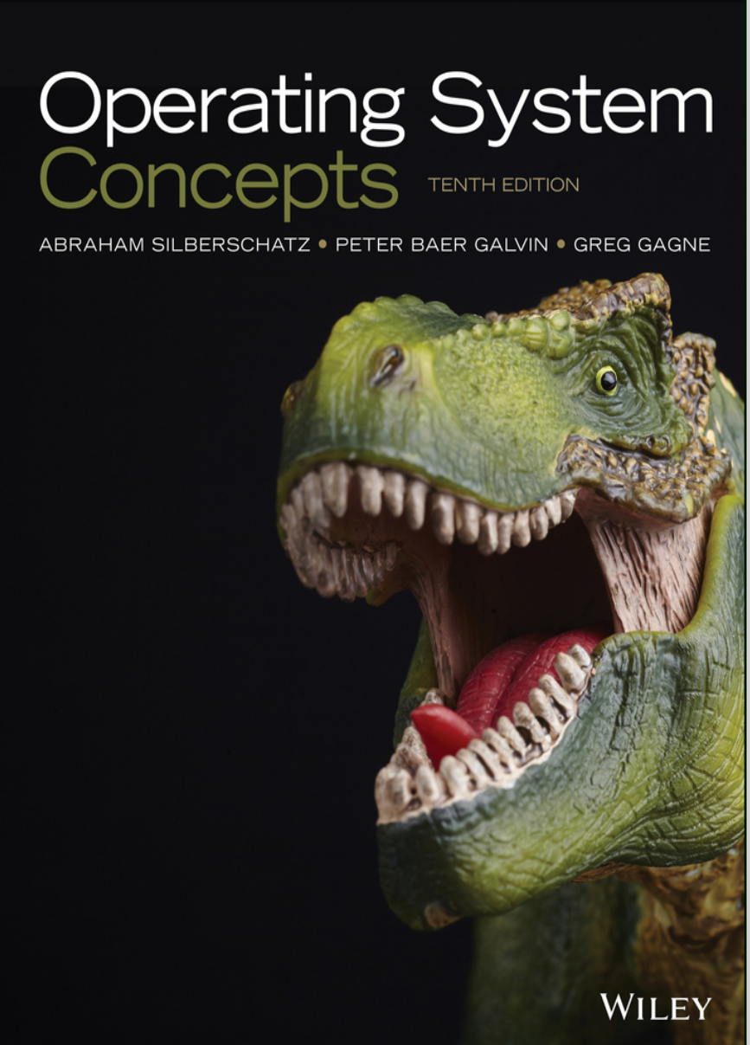

Operation Systems
Dr. A. Taghinezhad

Slide 2
ارزیابی
Contribution
Attendance
Homework
Exam
Grading
1
1
3
16
20+1
Notes:
Lesson descriptions should be brief.

Slide 3
Outline of this Course
Introduction
Processes
Threads and Concurrency
CPU Scheduling
Deadlocks
Main Memory
Virtual Memory
Mass-Storage Structure

Slide 4
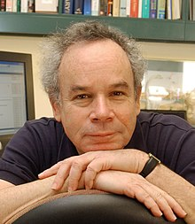
Chapter 1: Introduction

Slide 5
Chapter 1: Introduction
What Operating Systems Do
Computer-System Organization
Computer-System Architecture
Operating-System Structure
Operating-System Operations
Process Management
Memory Management
Storage Management
Protection and Security
Kernel Data Structures
Computing Environments
Open-Source Operating Systems

Slide 6
Objectives
To describe the basic organization of computer systems
To provide a grand tour of the major components of operating systems
To give an overview of the many types of computing environments
To explore several open-source operating systems

Slide 7
What is an Operating System?
A program that acts as an intermediary between a user of a computer and the computer hardware
Operating system goals:
Execute user programs and make solving user problems easier
Make the computer system convenient to use
Use the computer hardware in an efficient manner (Resource Utilization)
Notes:
Execute User Programs and Solve User Problems:
The operating system (OS) allows users to run various programs, making it easier to solve specific tasks. For instance:
Word Processing: Imagine you’re writing an important report. The OS lets you open a word processor (like Microsoft Word) to create, edit, and format your document.
Web Browsing: When you want to search for information online, the OS enables you to launch a web browser (such as Chrome or Firefox) to explore websites, read articles, and watch videos.
Make the Computer System Convenient to Use:
The OS provides a user-friendly interface, making interactions with the computer more convenient. Examples include:
Graphical User Interface (GUI): Instead of typing commands in a terminal, you can click icons, use menus, and drag files in a visually intuitive way.
File Management: The OS organizes files into folders, allowing you to easily find, open, and organize documents, images, and other files.
Efficient Hardware Utilization (Resource Management):
The OS ensures efficient use of computer resources (CPU, memory, storage). Here are some examples:
Multitasking: Suppose you’re listening to music, downloading files, and editing a spreadsheet simultaneously. The OS allocates CPU time and memory efficiently to handle all these tasks.
Virtual Memory: When RAM is scarce, the OS uses virtual memory (part of the hard drive) to store less frequently used data temporarily.

Slide 8
Computer System Structure
Computer system can be divided into four components:
Hardware – provides basic computing resources
CPU, memory, I/O devices
Operating system
Controls and coordinates use of hardware among various application The computerns and users
Application programs – define the ways in which the system resources are used to solve the computing problems of the users
Word processors, compilers, web browsers, database systems, video games
Users
People, machines, other computers

Slide 9
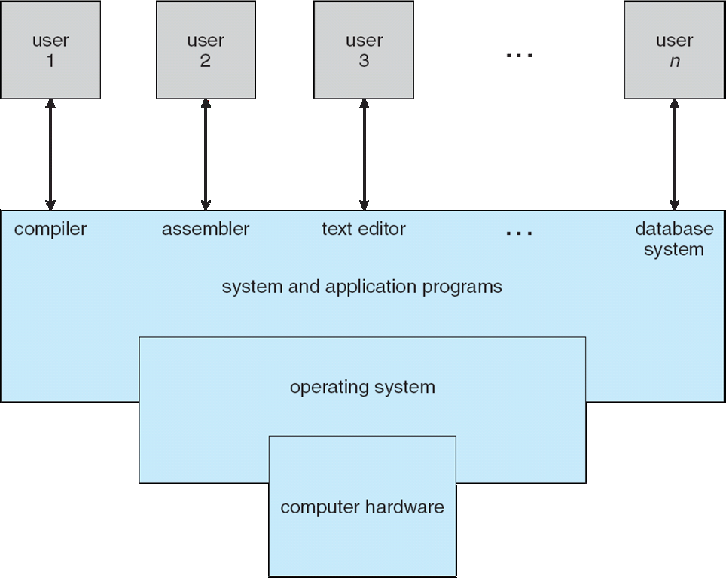
Four Components of a Computer System

Slide 10
What Operating Systems Do
Depends on the point of view
Users want convenience, ease of use and good performance
Don’t care about resource utilization
But shared computer such as mainframe or minicomputer must keep all users happy
Users of dedicate systems such as workstations have dedicated resources but frequently use shared resources from servers
Handheld computers are resource poor, optimized for usability and battery life
Some computers have little or no user interface, such as embedded computers in devices and automobiles
Notes:
andheld Computers:
Handheld devices (e.g., smartphones, tablets) are resource-constrained but optimized for usability and portability.
Key characteristics:
Limited Resources: Smaller memory, processing power, and battery life.
User-Centric Design: Focus on ease of use, mobility, and energy efficiency.
Multitasking Constraints: Running multiple apps simultaneously can strain resources.
Challenges:
Battery Life: Balancing functionality with power consumption.
Usability: Ensuring a smooth user experience despite limitations.
Resource Management: Efficiently allocating resources for various tasks.

Slide 11
Operating System Definition
OS is a resource allocator
Manages all resources
Decides between conflicting requests for efficient and fair resource use
OS is a control program
Controls execution of programs to prevent errors and improper use of the computer

Slide 12
Operating System Definition (Cont.)
No universally accepted definition
“Everything a vendor ships when you order an operating system” is a good approximation
But varies wildly
“The one program running at all times on the computer” is the kernel.
Everything else is either
a system program (ships with the operating system) , or
an application program.
Notes:
"همه چیزهایی که فروشنده هنگام سفارش یک سیستم عامل ارسال می کند" تقریب خوبی است
Kernel: The kernel is the core component of the operating system. It manages critical tasks like memory allocation, process scheduling, device communication, and resource allocation.

Slide 13
Computer Startup
bootstrap program is loaded at power-up or reboot
Typically stored in ROM or EPROM, generally known as firmware
Initializes all aspects of system
Loads operating system kernel and starts execution
Notes:
Bootstrap: خودراه‌انداز
برنامه بوت استرپ با روشن شدن یا راه اندازی مجدد بارگذاری می شود
معمولاً در ROM یا EPROM ذخیره می شود که معمولاً به عنوان سیستم عامل شناخته می شود
تمام جنبه های سیستم را راه اندازی می کند
هسته سیستم عامل را بارگیری می کند و اجرا را شروع می کند

Slide 14
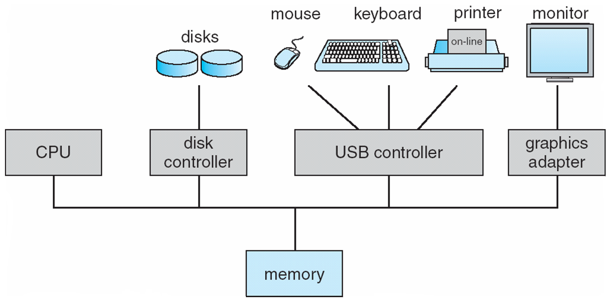
Computer System Organization
Computer-system operation
One or more CPUs, device controllers connect through common bus providing access to shared memory
Concurrent execution of CPUs and devices competing for memory cycles
Notes:
Organization: تشکیلات

Slide 15
Computer-System Operation
I/O devices and the CPU can execute concurrently
Each device controller is in charge of a particular device type
Each device controller has a local buffer
CPU moves data from/to main memory to/from local buffers
I/O is from the device to local buffer of controller
Device controller informs CPU that it has finished its operation by causing an interrupt
Notes:
Operation عملیات
A device controller is an electronic component responsible for handling the communication between the CPU (central processing unit) and various I/O devices.

Slide 16
Device controller
A device controller in an operating system (OS) plays a crucial role in managing communication between the computer system and input/output (I/O) devices.
Definition:
A device controller is an electronic component responsible for handling the communication between the CPU (central processing unit) and various I/O devices.
It acts as an interface between the computer system (operating system) and the I/O devices.
Convert Serial bits stream to blocks of Bytes.
Notes:
Each device has mechanical and electrical Components (Device Controller).
One mechanical component may have multiple device controllers like HDD.

Slide 17
device controller
Controller's tasks :
It converts serial bit stream to block of bytes.
Perform error correction if necessary.
Block of bytes is first assembled bit by bit in buffer inside the controller.
After verification, the block has been declared to be error free and then it can be copied to main memory
Notes:
magine you have a hard disk drive (HDD) in your computer. Now, a hard disk drive controller manages the data read from and written to the hard disk. Here’s a breakdown of its tasks:
Serial Bit Stream to Bytes: It converts the continuous stream of data from the disk into manageable blocks of bytes.
Error Correction: It ensures that any errors in the data are corrected before proceeding.
Data Assembly: The block of bytes is first assembled bit by bit in a buffer inside the controller.
Data Verification and Transfer: After verification, the block is declared to be error-free and then transferred to the computer's main memory.
In essence, the HDD controller is responsible for efficiently managing and verifying data before it reaches your computer, ensuring that everything runs smoothly!

Slide 18
Interrupt
An interrupt in an operating system (OS) is a signal emitted by either hardware or software when a process or an event requires immediate attention (high-priority process).
Notes:
Handling Interrupts: When an interrupt occurs:
The processor stops its current execution.
It switches to a specific interrupt handler code associated with the interrupt type.
The interrupt handler completes necessary work (e.g., handling errors) before returning control to the interrupted application.

Slide 19
Interrupt
Hardware Interrupts: These are related to the state of hardware devices.
Examples include interrupt request (IRQ) lines on a PC or signals from devices embedded in processor logic (e.g., CPU timers).
Software Interrupts: These are produced by software or the system itself (as opposed to hardware). (Traps)
Interrupt Latency: The delay between receiving an interrupt and starting the execution of the interrupt handler.
Notes:
Handling Interrupts: When an interrupt occurs:
The processor stops its current execution.
It switches to a specific interrupt handler code associated with the interrupt type.
The interrupt handler completes necessary work (e.g., handling errors) before returning control to the interrupted application.

Slide 20
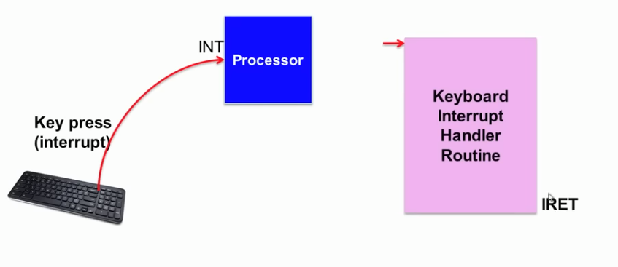
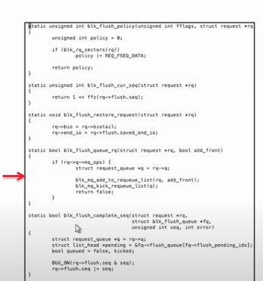
Hardware Interrupt
Notes:
During execution of a program, a key pressed, for example it wants to abort the program execution.
The IRET instruction is used to exit from an interrupt procedure. IRET is similar to RET except that IRET increments ESP by an extra four bytes (because of the flags on the stack) and moves the saved flags into the EFLAGS register.
The EFI (Extensible Firmware Interface) system partition or ESP is a partition on a data storage device (usually a hard disk drive or solid-state drive) that is used by computers that have the Unified Extensible Firmware Interface (UEFI)

Slide 21
Common Functions of Interrupts
Interrupt transfers control to the interrupt service routine generally, which contains the addresses of all the service routines
Interrupt architecture must save the address of the interrupted instruction
A trap or exception is a software-generated interrupt caused either by an error or a user request, System Calls, Synchronous Event
An operating system is interrupt-driven
Notes:
Hardware may trigger an interrupt at any time by sending a signal to the CPU, usually by way of the system bus.
When the CPU is interrupted, it stops what it is doing and immediately transfers execution to a fixed location. The fixed location usually contains the starting address where the service routine for the interrupt is located. The interrupt service routine executes; on completion, the CPU resumes the interrupted computation.
Each computer design has its own interrupt mechanism, but several functions are common.

Slide 22
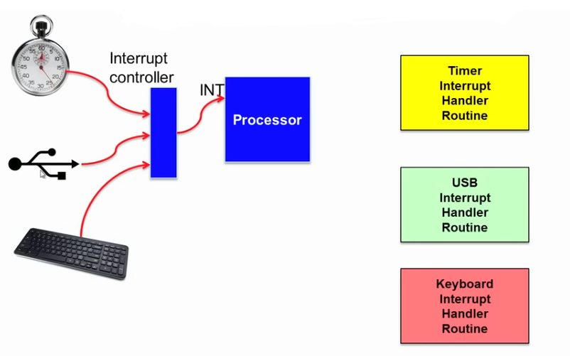
Interrupt Handling
The operating system preserves the state of the CPU by storing registers and the program counter
Determines which type of interrupt has occurred
Separate segments of code determine what action should be taken for each type of interrupt
Notes:
Preserves حفظ کردن
Consider a typical computer operation: a program performing I/O. To start an I/O operation, the device driver loads the appropriate registers in the device controller. The device controller, in turn, examines the contents of these registers to determine what action to take (such as “read a character from the keyboard”). The controller starts the transfer of data from the device to its local buffer. Once the transfer of data is complete, the device controller informs the device driver that it has finished its operation. The device driver then gives control to other parts of the operating system, possibly returning the data or a pointer to the data if the operation was a read. For other operations, the device driver returns status information such as “write completed successfully” or “device busy”. But how does the controller inform the device driver that it has finished its operation? This is accomplished via an interrupt.

Slide 23
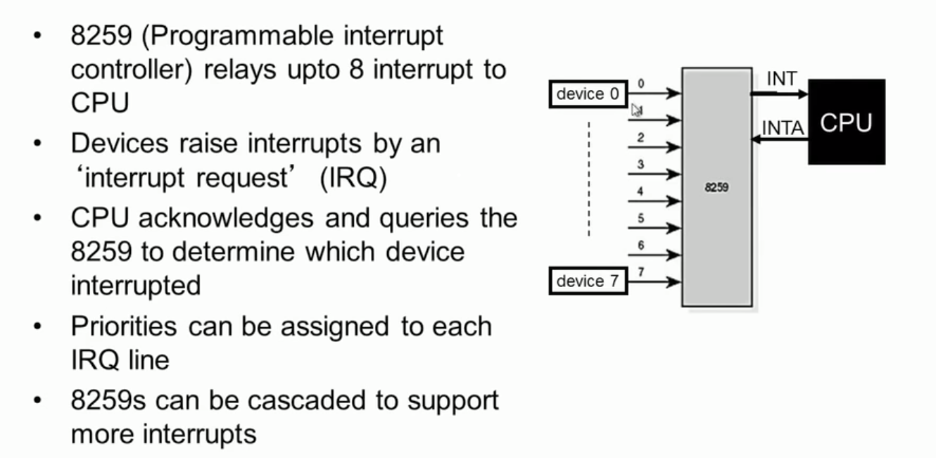
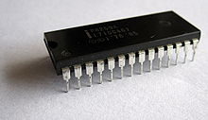
Programmable Interrupt Controller
The Intel 8259 is a programmable interrupt controller (PIC) designed for the Intel 8085 and Intel 8086 microprocessors.
Notes:
One of the interrupt handlers is 8259, it communicates with CPU through INT(Interrupt) pin of CPU and CPU acknowledges the request through its INTA pin to determine which device interrupted.
It can be cascaded to support more than 8 Devices.
nterrupt handlers can be on the motherboard in legacy systems and on the CPUs in new systems.

Slide 24
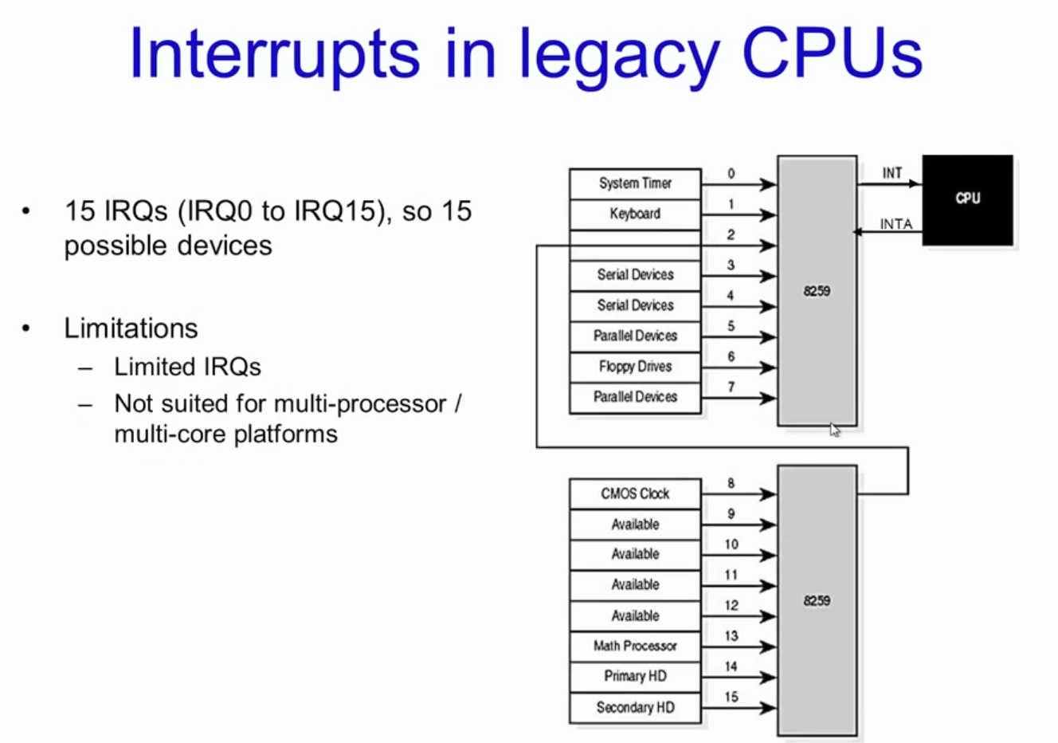
Notes:
In legacy computers, there are two controllers one is considered master and the other is considered slave.

Slide 25
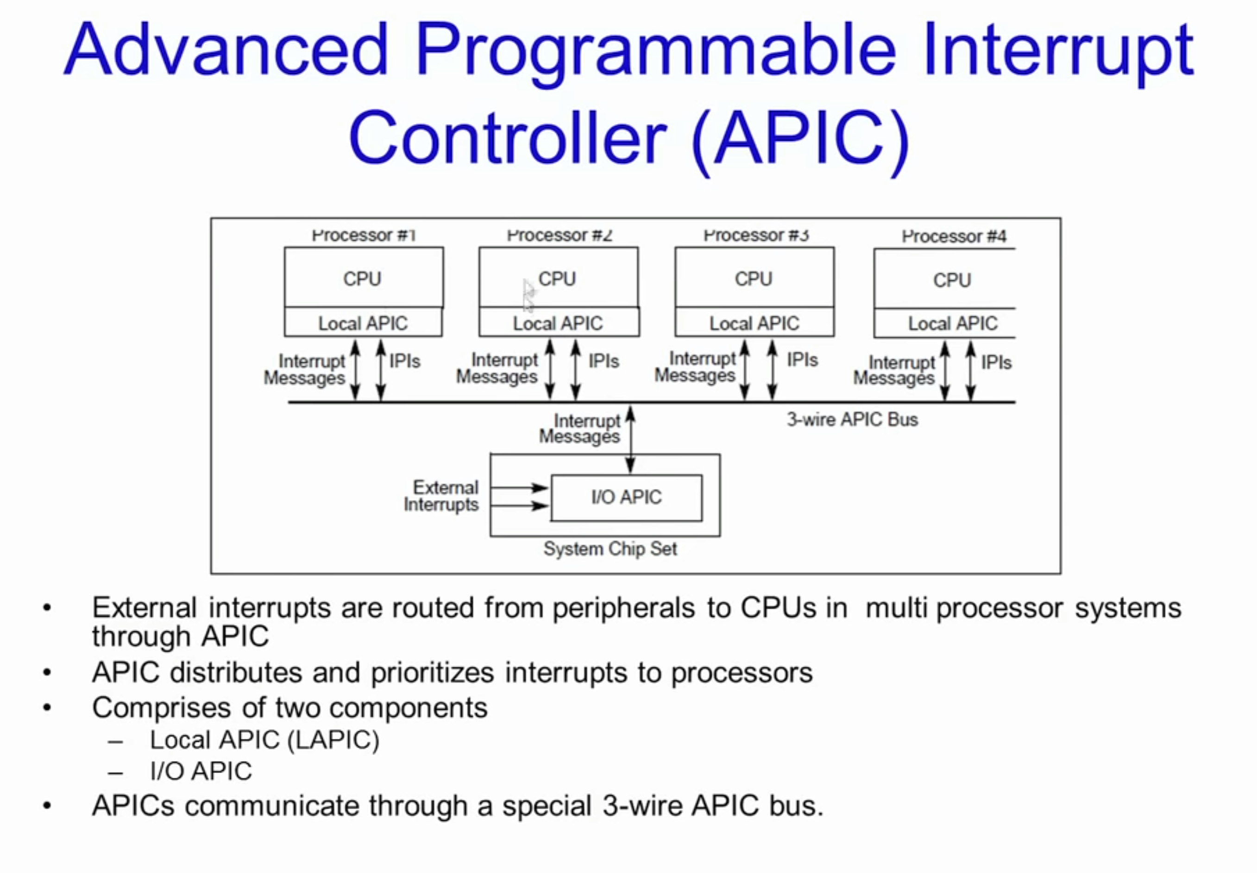
New systems Interrupt handler per CPU
Notes:
New systems intruppt handers.
External Keyboards can as request interrupt through System Chip Set (I/o APIC) which will be channelized one of local APICs bus to CPU. Local APICs communicate interrupt messages to
LAPIC (local apic):- Receives interrupts from I/O APIC and routes it to the local CPU
- Can also receive local interrupts (such as from thermal sensor,internal timer, etc)- Send and receive IPIs (Inter processor interrupts). IPls used to distribute interrupts between processors or executesystem wide functions like booting, load distribution, etc.·
I/O APIC- Present in chipset (north bridge)-
Used to route external interrupts to local APIC

Slide 26
I/O Structure
After I/O starts, control returns to user program only upon I/O completion
Wait instruction idles the CPU until the next interrupt
Wait loop (contention for memory access)
At most one I/O request is outstanding at a time, no simultaneous I/O processing
After I/O starts, control returns to user program without waiting for I/O completion
System call – request to the OS to allow user to wait for I/O completion
Device-status table contains entry for each I/O device indicating its type, address, and state
OS indexes into I/O device table to determine device status and to modify table entry to include interrupt
Notes:
Contention رقابت

Slide 27
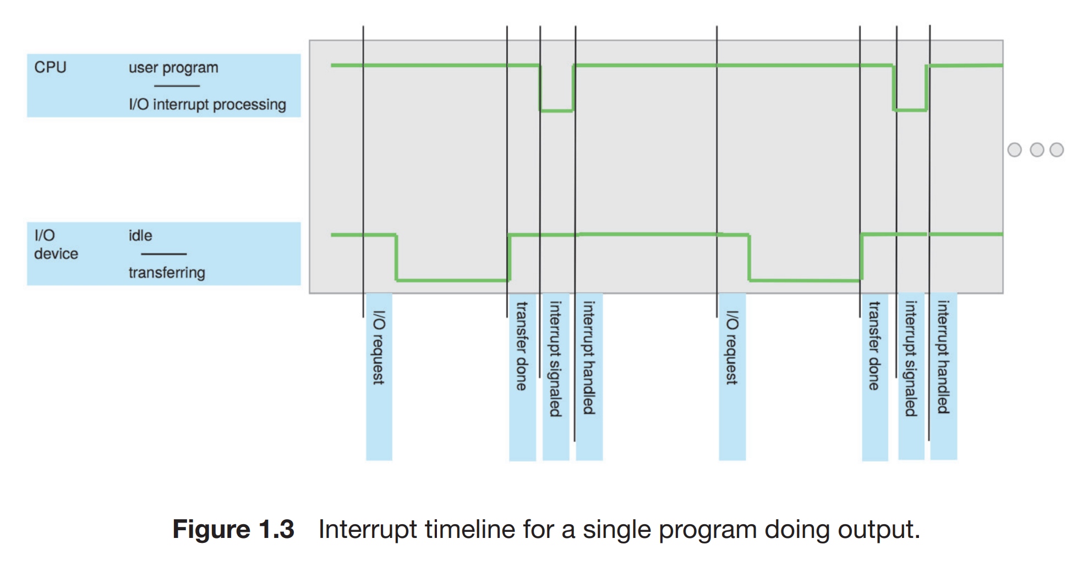
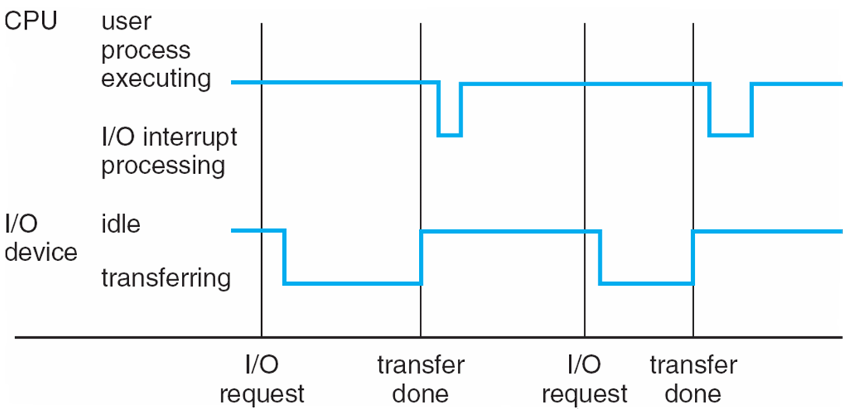
Interrupt Timeline
Notes:
When the CPU is interrupted, it stops what it is doing and immediately transfers execution to a fixed location. The fixed location usually contains the starting address where the service routine for the interrupt is located. The interrupt service routine executes; on completion, the CPU resumes the interrupted computation.

Slide 28
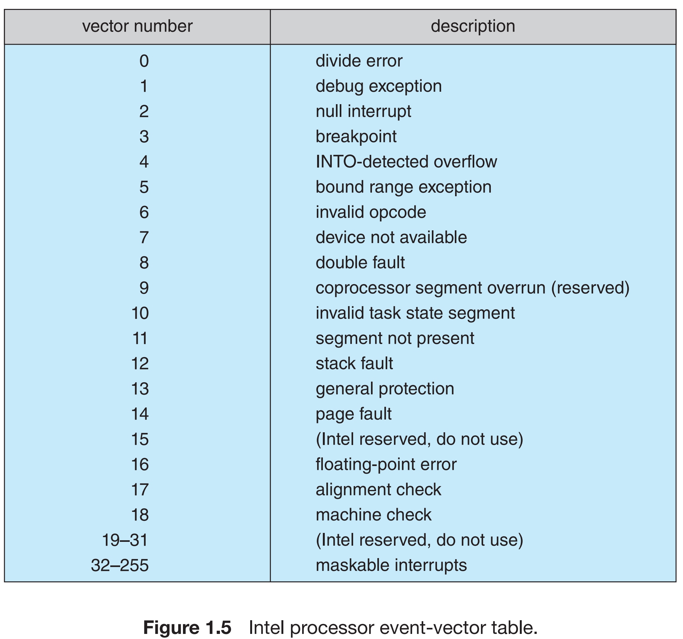
Notes:
Figure 1.5 illustrates the design of the interrupt vector for Intel processors. The events from 0 to 31, which are nonmaskable, are used to signal various error conditions. The events from 32 to 255, which are maskable, are used for purposes such as device-generated interrupts.

Slide 29
Storage Definitions and Notation Review
The basic unit of computer storage is the bit. A bit can contain one of two values, 0 and 1.
All other storage in a computer is based on collections of bits. Given enough bits, it represent: numbers, letters, images, movies, sounds, documents, and programs, to name a few.
A byte is 8 bits, and on most computers it is the smallest convenient chunk of storage. A less common term is word, which is a given computer architecture’s native unit of data.
Computer storage, along with most computer throughput, is generally measured and manipulated in bytes and collections of bytes.
A kilobyte, or KB, is 1,024 bytes
a megabyte, or MB, is 1,024² bytes
a gigabyte, or GB, is 1,024³ bytes
a terabyte, or TB, is 1,024⁴ bytes
a petabyte, or PB, is 1,024⁵ bytes
Notes:
The CPU can load instructions only from memory, so any programs must first be loaded into memory to run. General-purpose computers run most of their programs from rewritable memory, called main memory.
All forms of memory provide an array of bytes.
Each byte has its own address. Interaction is achieved through a sequence of load or store instructions to specific memory addresses. The load instruction moves a byte or word from main memory to an internal register within the CPU, whereas the store instruction moves the content of a register to main memory. Aside from explicit loads and stores, the CPU automatically loads instructions from main memory for execution from the location stored in the program counter

Slide 30
Storage Structure
Main memory – only large storage media that the CPU can access directly
Random access
Typically volatile
Secondary storage – extension of main memory that provides large nonvolatile storage capacity
Notes:
حافظه اصلی - فقط رسانه های ذخیره سازی بزرگ که CPU می تواند مستقیماً به آنها دسترسی داشته باشد
دسترسی تصادفی
به طور معمول فرار
ذخیره سازی ثانویه - گسترش حافظه اصلی که ظرفیت ذخیره سازی غیرفرار زیادی را فراهم می کند

Slide 31
Storage Structure
Hard disks – rigid metal or glass platters covered with magnetic recording material
Disk surface is logically divided into tracks, which are subdivided into sectors
The disk controller determines the logical interaction between the device and the computer
Solid-state disks – faster than hard disks, nonvolatile
Various technologies
Becoming more popular
Notes:
دیسک‌های سخت – بشقاب‌های فلزی یا شیشه‌ای سفت و سخت که با مواد ضبط مغناطیسی پوشانده شده‌اند
سطح دیسک به طور منطقی به آهنگ هایی تقسیم می شود که به بخش هایی تقسیم می شوند
کنترل کننده دیسک تعامل منطقی بین دستگاه و رایانه را تعیین می کند
دیسک‌های حالت جامد - سریع‌تر از دیسک‌های سخت، غیرفرار
فن آوری های مختلف
محبوب تر شدن

Slide 32
Storage Hierarchy
Storage systems organized in hierarchy
Speed
Cost
Volatility
Caching – copying information into faster storage system; main memory can be viewed as a cache for secondary storage
Device Driver for each device controller to manage I/O
Provides uniform interface between controller and kernel
Notes:
Caching example: When you visit a website for the first time, your web browser stores some of the website’s data on your local machine. This data can include things like images, stylesheets, and JavaScript files. This is known as caching.
The next time you visit the same website, instead of downloading all the data again, your browser can load much of it from the local cache. This makes the website load faster, providing a smoother and more efficient browsing experience.

Slide 33
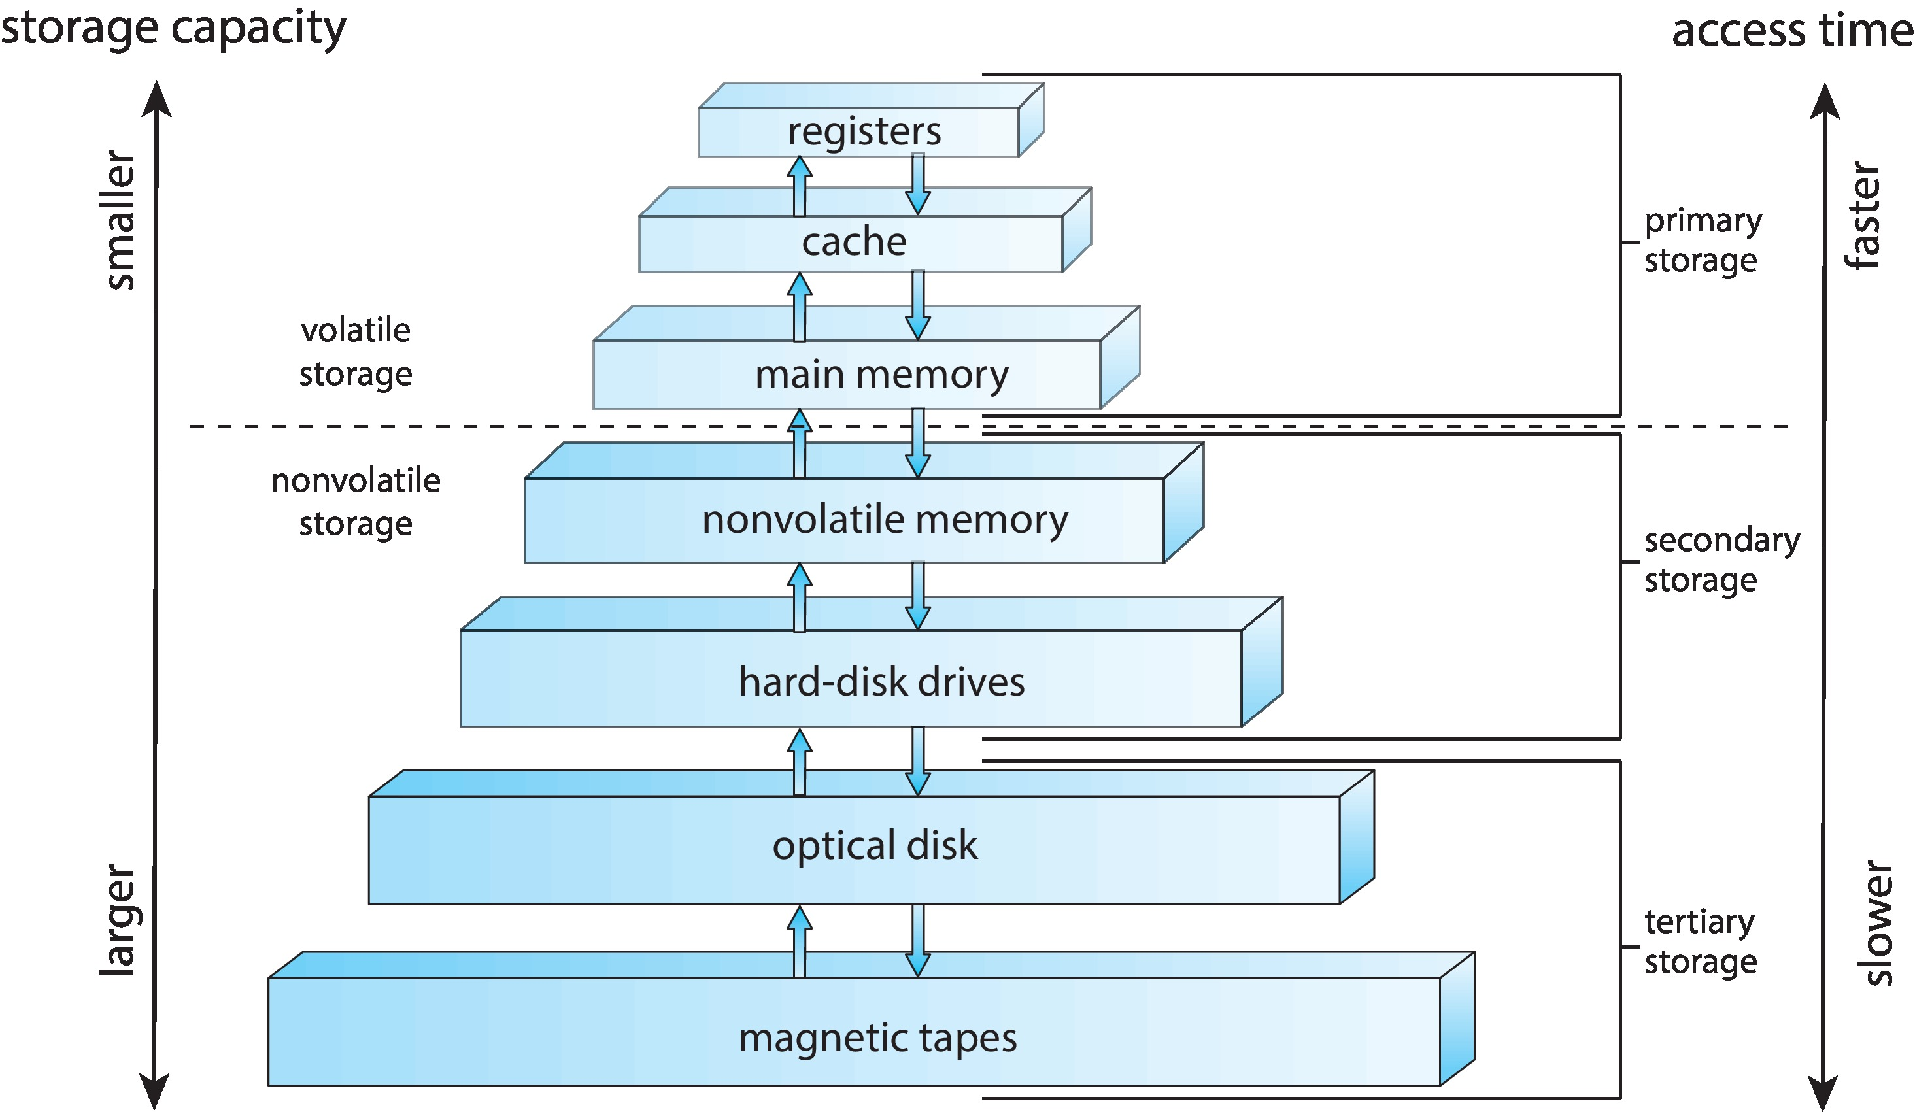
Storage-Device Hierarchy
Notes:
The top four levels of memory in the figure are constructed using semiconductor memory, which consists of semiconductor-based electronic circuits. NVM devices, at the fourth level, have several variants but in general are faster than hard disks.
The most common form of NVM device is flash memory, which is popular in mobile devices such as smartphones and tablets.

Slide 34
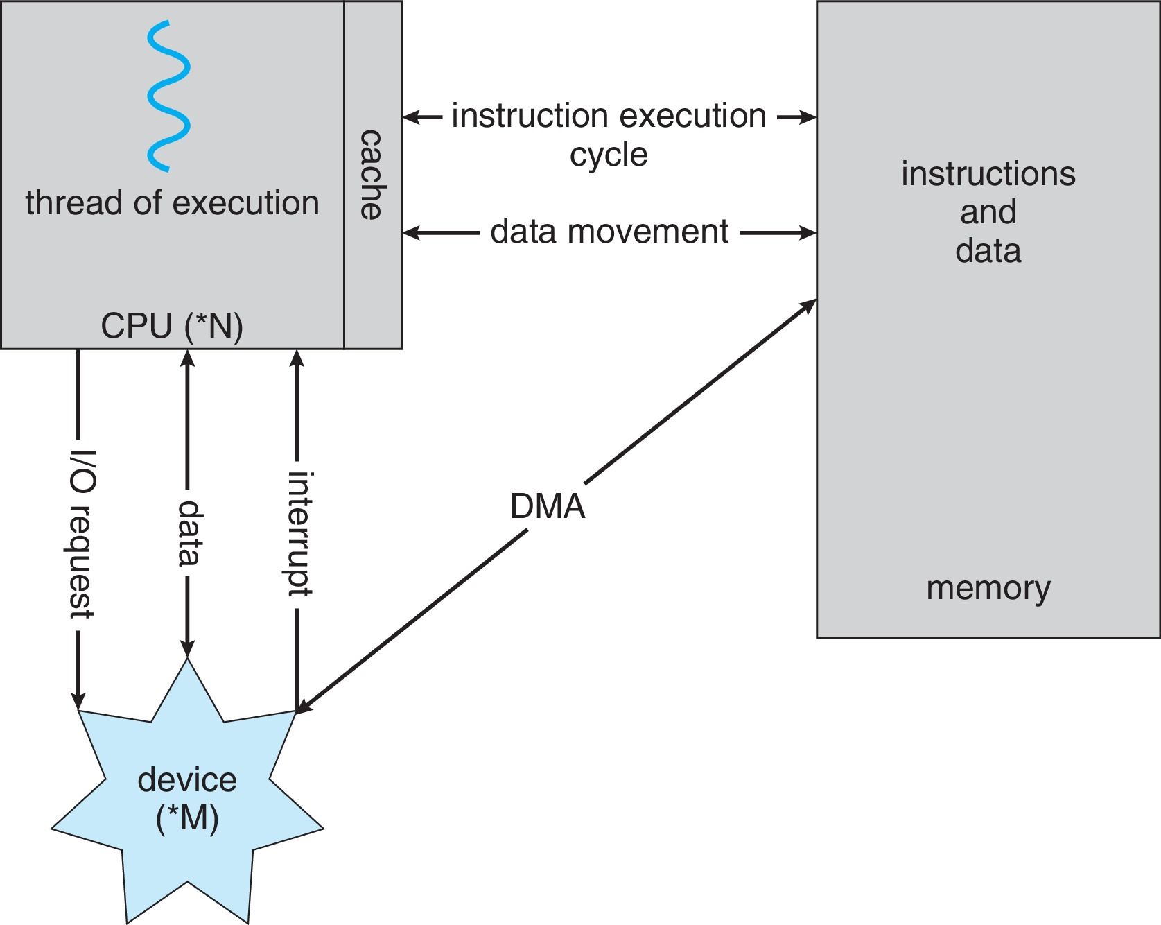
How a Modern Computer Works
A von Neumann architecture
Notes:
معماری فون نویمان

Slide 35
Direct Memory Access Structure
It is a hardware device that allows certain hardware device that allows certain subsystems to access main memory (RAM), independent of the central processing unit (CPU).
This feature is useful when the CPU needs to perform useful work while waiting for a relatively slow I/O data transfer.
Hardware systems that use DMA: disk drive, graphics cards, network cards, sound cards
Notes:
Only one interrupt is generated per block, rather than one interrupt per byte
The form of interrupt-driven I/O described in Section 1.2.1 is fine for moving small amounts of data but can produce high overhead when used for bulk data movement such as NVS I/O. To solve this problem, direct memory access (DMA) is used.
After setting up buffers, pointers, and counters for the I/O device, the device controller transfers an entire block of data directly to or from the device and main memory, with no intervention by the CPU. Only one interrupt is generated per block, to tell the device driver that the operation has completed, rather than the one interrupt per byte generated for low-speed devices. While the device controller is performing these operations, the CPU is available to accomplish other work.
پس از تنظیم بافرها، اشاره گرها و شمارنده ها برای دستگاه ورودی/خروجی، کنترلر دستگاه یک بلوک کامل از داده ها را مستقیماً به یا از دستگاه و حافظه اصلی، بدون دخالت CPU، منتقل می کند. در هر بلوک فقط یک وقفه ایجاد می شود تا به راننده دستگاه بگوید که عملیات کامل شده است، به جای یک وقفه در هر بایت تولید شده برای دستگاه های کم سرعت. در حالی که کنترل کننده دستگاه این عملیات را انجام می دهد، CPU برای انجام کارهای دیگر در دسترس است.

Slide 36
Direct Memory Access Structure
Without DMA, when the CPU is using programmed input/output, it is typically fully occupied for the entire duration of the read or write operation, and is thus unavailable to perform other work.
With DMA, the CPU first initiates the transfer, then it does other operations while the transfer is in progress, and it finally receives an interrupt from the DMA controller when the operation is done.
Notes:
Only one interrupt is generated per block, rather than one interrupt per byte
The form of interrupt-driven I/O described in Section 1.2.1 is fine for moving small amounts of data but can produce high overhead when used for bulk data movement such as NVS I/O. To solve this problem, direct memory access (DMA) is used.
After setting up buffers, pointers, and counters for the I/O device, the device controller transfers an entire block of data directly to or from the device and main memory, with no intervention by the CPU. Only one interrupt is generated per block, to tell the device driver that the operation has completed, rather than the one interrupt per byte generated for low-speed devices. While the device controller is performing these operations, the CPU is available to accomplish other work.
پس از تنظیم بافرها، اشاره گرها و شمارنده ها برای دستگاه ورودی/خروجی، کنترلر دستگاه یک بلوک کامل از داده ها را مستقیماً به یا از دستگاه و حافظه اصلی، بدون دخالت CPU، منتقل می کند. در هر بلوک فقط یک وقفه ایجاد می شود تا به راننده دستگاه بگوید که عملیات کامل شده است، به جای یک وقفه در هر بایت تولید شده برای دستگاه های کم سرعت. در حالی که کنترل کننده دستگاه این عملیات را انجام می دهد، CPU برای انجام کارهای دیگر در دسترس است.

Slide 37
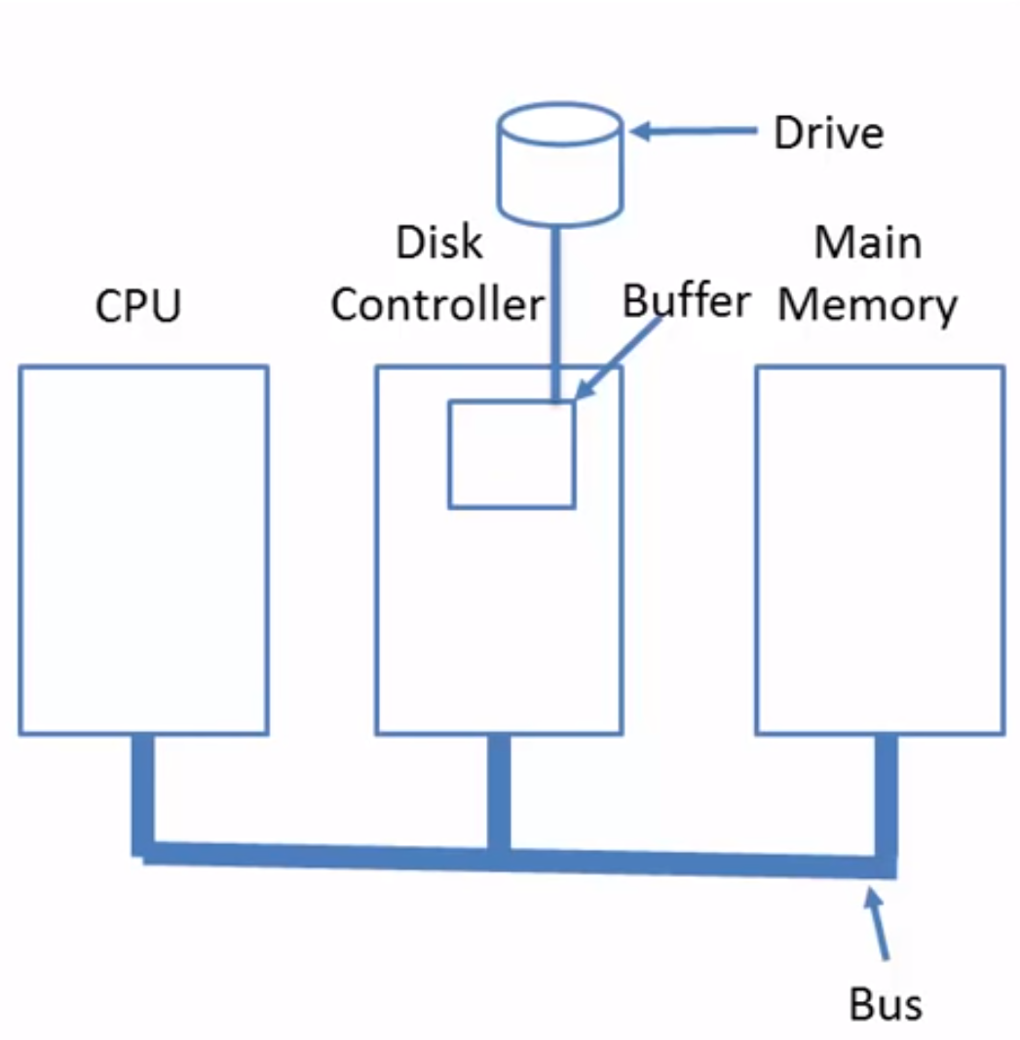
Disk read-write without a DMA
The disk controller reads the block from the drive serially, bit by bit until the entire block is in the controller's buffer.
It computes the checksum to verify that no read errors have occurred.
Then the controller causes an interrupt so that OS can read the block from controller's buffer (a byte or a word at a time) by executing a loop.
After reading every single part of the block from the controller device register, the operating system will store them in the main memory.
Notes:
Suppose, the a data needs to be read from disk.

Slide 38
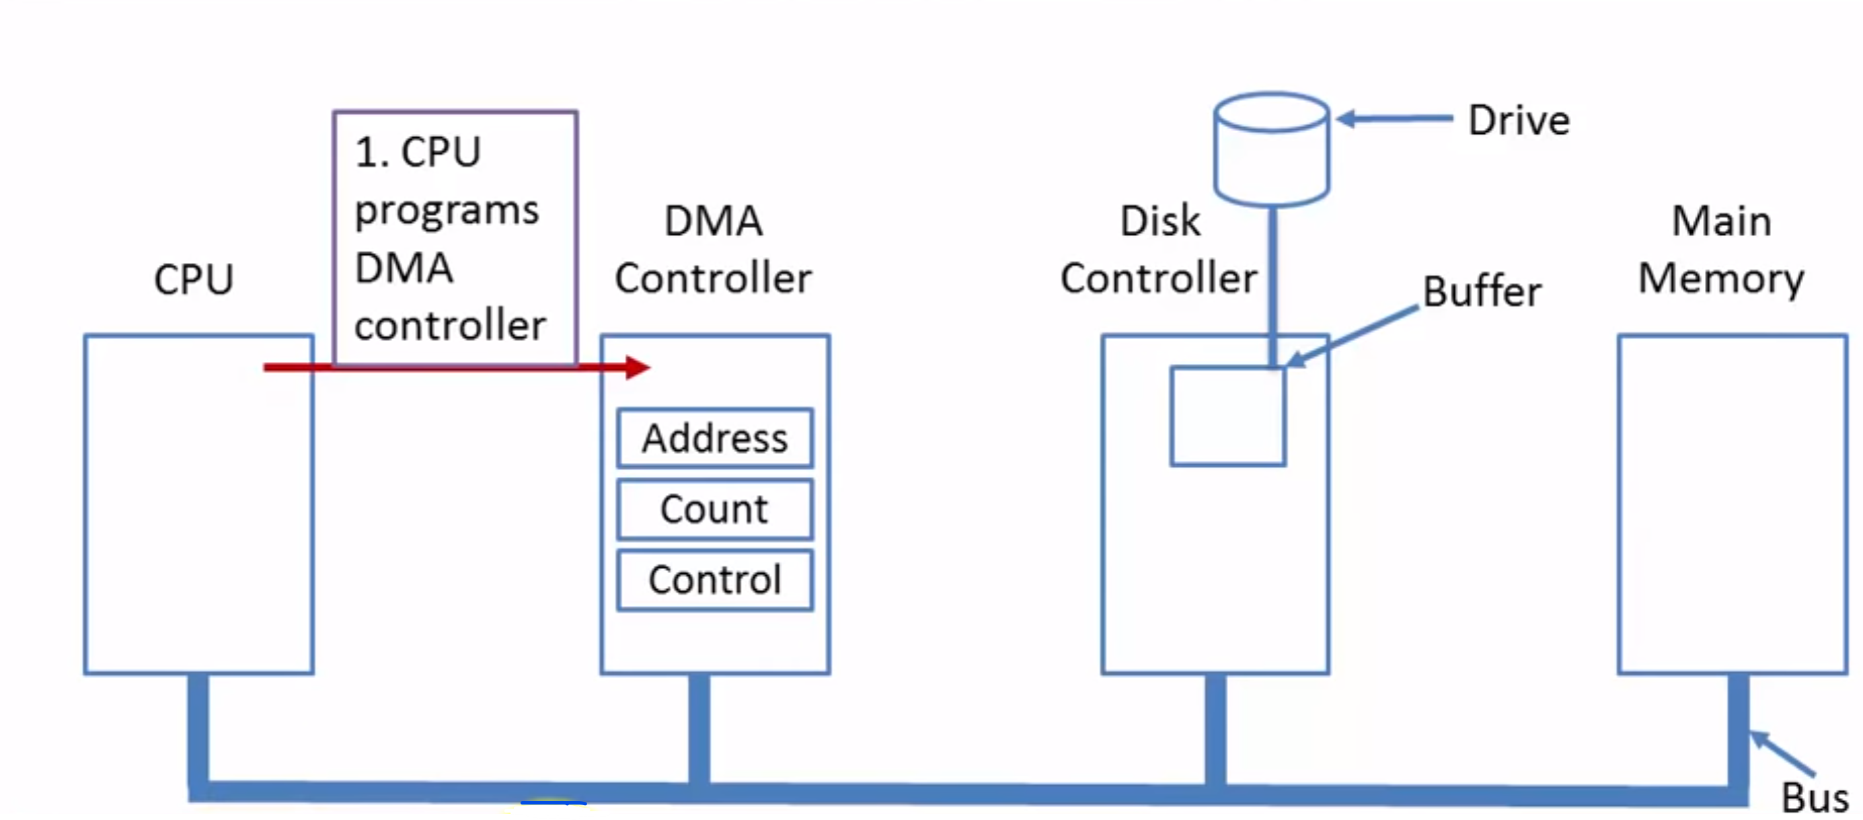
Step 1:
First the CPU programs the DMA controller by setting its registers so it knows what to transfer where.
It also issues a command to the disk controller to read data from the disk into its internal buffer and verify the checksum.
When valid data are in the disk controller's buffer, DMA can begin.

Slide 39
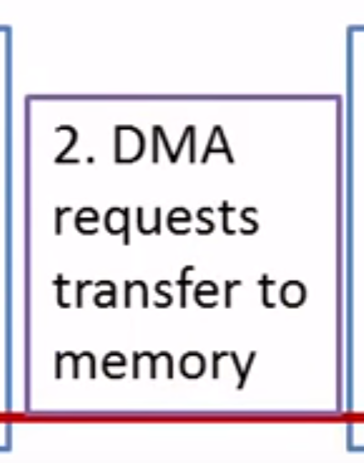
Step 2:
The DMA controller initiates the transfer by issuing a read request over the bus to the disk controller.
The disk controller does not know (or care) whether it came from the CPU or a DMA controller.
Step 3: The data from the buffer moves to main memory

Slide 40
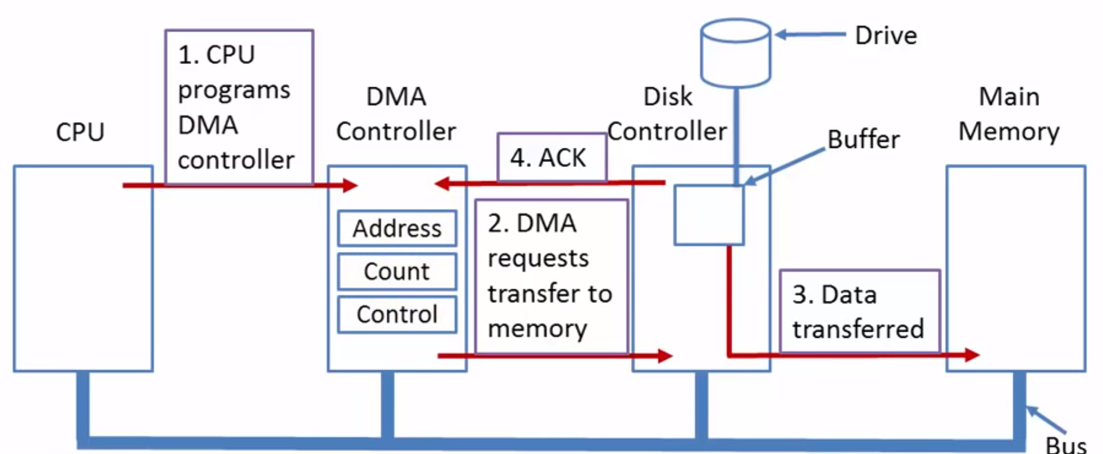
Step 4:
When the write is complete, the disk controller sends an ASK signal to the DMA controller over the bus.
The DMA controller then increments the memory address in DMA control to use and decrements the byte Count.
If the byte count is still greater than 0, steps 2 to 4 are repeated until it reaches 0. It lets the CPU know the transfer is completed by Interrupt.
Notes:
Byte Count inside the DMA controller is the count of the number of operation. E.g., reading multiple number of blocks from buffer.
With this DMA, when the OS starts up, it does not have to copy the disk block to memory; it is already there.

Slide 41
Modes of Bus operation
The buses can be operated in two modes
1. Word-at-a-time mode:
Here the DMA requests for the transfer of one word and gets it.
If CPU wants the bus at the same time then it has to wait.
This mechanism is known as Cycle.
2. Block mode:
Here the DMA controller tells the device to acquire the bus, issues a series of transfers, and then releases the bus.
This form of the operation is called Burst mode.
It is more efficient than cycle.

Slide 42
Operating-System Operations
Bootstrap program – simple code to initialize the system, load the kernel
Kernel loads
Starts system daemons (services provided outside of the kernel)
Kernel interrupt driven (hardware and software)
Hardware interrupt by one of the devices
Software interrupt (exception or trap):
Software error (e.g., division by zero)
Request for operating system service – system call
Other process problems include infinite loop, processes modifying each other or the operating system
Notes:
system daemons برنامه‌های پشت زمینه. به معنی روح
For a computer to start running— for instance, when it is powered up or rebooted—it needs to have an initial program to run. As noted earlier, this initial program, or bootstrap program, tends to be simple. Typically, it is stored within the computer hardware in firmware. It initializes all aspects of the system, from CPU registers to device controllers to memory contents.
the bootstrap program must locate the operating-system kernel and load it into memory
Once the kernel is loaded and executing, it can start providing services to the system and its users. Some services are provided outside of the kernel by system programs that are loaded into memory at boot time to become system daemons, which run the entire time the kernel is running. On Linux, the first system program is “systemd,” and it starts many other daemons. Once this phase is complete, the system is fully booted, and the system waits for some event to occur.
Events are almost always signaled by the occurrence of an interrupt

Slide 43
Multiprogramming (Batch system)
Single user cannot always keep CPU and I/O devices busy
Multiprogramming organizes jobs (code and data) so CPU always has one to execute
A subset of total jobs in system is kept in memory
One job selected and run via job scheduling
When job has to wait (for I/O for example), OS switches to another job
Notes:
In a multiprogrammed system, a program in execution is termed a process

Slide 44
Multitasking (Timesharing)
the CPU switches jobs so frequently that users can interact with each job while it is running, creating interactive computing
Response time should be < 1 second
Each user has at least one program executing in memory, which is called process
If several jobs ready to run at the same time  CPU scheduling
If processes don’t fit in memory, swapping moves them in and out to run
Virtual memory allows execution of processes not completely in memory
Notes:
-Consider that when a process executes, it typically executes for only a short time before it either finishes or needs to perform I/O. I/O may be interactive; that is, output goes to a display for the user, and input comes from a user keyboard, mouse, or touch screen. Since interactive I/O typically runs at “people speeds,” it may take a long time to complete. E.g., a calculator

Slide 45
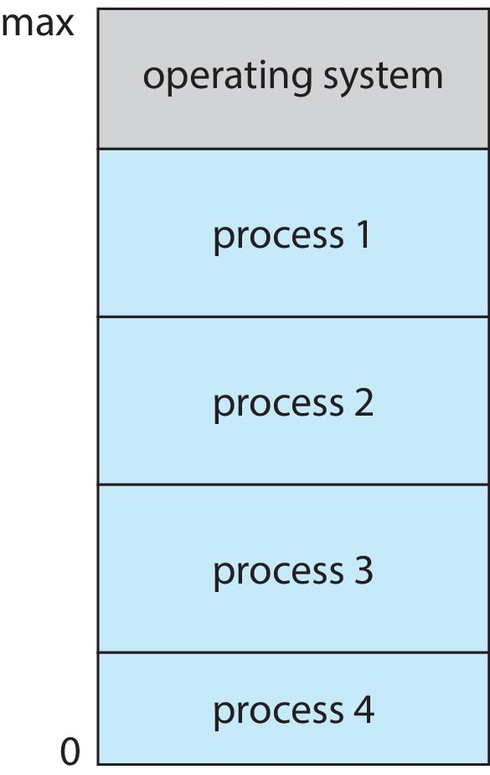
Memory Layout for Multiprogrammed System
Notes:
-Having several processes in memory at the same time requires some form of memory management, which we cover in Chapter 9 and Chapter 10.
-In a multitasking system, the operating system must ensure reasonable response time. A common method for doing so is virtual memory, a technique that allows the execution of a process that is not completely in memory.
-The main advantage of this scheme is that it enables users to run programs that are larger than actual physical memory.

Slide 46
Dual-mode Operation
Dual-mode operation allows OS to protect itself and other system components
User mode and kernel mode
Mode bit provided by hardware
Provides ability to distinguish when system is running user code or kernel code.
When a user is running ➔ mode bit is “user”
When kernel code is executing ➔ mode bit is “kernel”
How do we guarantee that user does not explicitly set the mode bit to “kernel”?
System call changes mode to kernel, return from call resets it to user
Some instructions designated as privileged, only executable in kernel mode
Notes:
-Since the operating system and its users share the hardware and software resources of the computer system, a properly designed operating system must ensure that an incorrect (or malicious) program cannot cause other programs —or the operating system itself— to execute incorrectly
Scenario: File System Access
User Mode:
Imagine a user running a text editor application. The text editor operates in user mode.
The user wants to save a document to the file system (e.g., create a new file or overwrite an existing one).
Kernel Mode:
The operating system runs in kernel mode.
When the user initiates the file save action, the text editor sends a system call request to the operating system.
The operating system switches to kernel mode to handle the request.
Protection Mechanisms in Action:
Privileged Instruction: The text editor cannot directly write to the file system. Instead, it invokes a privileged system call (e.g., write()).
Interrupt Handling: If the file system is busy or encounters an error, the operating system handles it gracefully without crashing the entire system.
Memory Protection: The operating system ensures that the text editor’s memory access is within its allocated space.
Result:
The operating system processes the system call, writes the document to the file system, and returns control to the text editor.
The user’s data is saved securely, and the system remains stable.

Slide 47
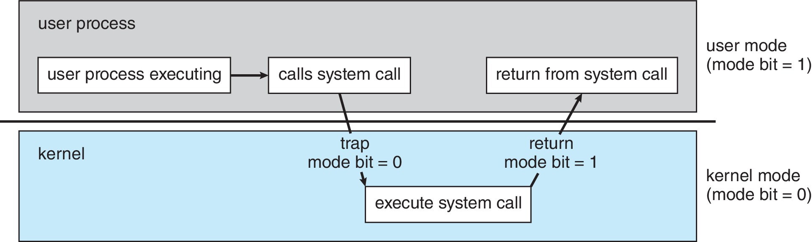
Transition from User to Kernel Mode
At system boot time, the hardware starts in kernel mode. The operating system is then loaded and starts user applications in user mode
Notes:
-Whenever a trap or interrupt occurs, the hardware switches from user mode to kernel mode (that is, changes the state of the mode bit to 0). Thus, whenever the operating system gains control of the computer, it is in kernel mode. The system always switches to user mode (by setting the mode bit to 1) before passing control to a user program.
-مفهوم حالت ها را می توان فراتر از دو حالت گسترش داد. به عنوان مثال، پردازنده های اینتل دارای چهار حلقه حفاظتی جداگانه هستند که حلقه 0 حالت هسته و حلقه 3 حالت کاربر است. (اگرچه حلقه های 1 و 2 را می توان برای سرویس های مختلف سیستم عامل استفاده کرد، اما در عمل به ندرت مورد استفاده قرار می گیرند.) سیستم های ARMv8 دارای هفت حالت هستند. CPUهایی که از مجازی سازی پشتیبانی می کنند (بخش 18.1) اغلب دارای یک حالت جداگانه برای نشان دادن زمانی است که مدیر ماشین مجازی (VMM) است.
در کنترل سیستم

Slide 48
Timer
Timer to prevent infinite loop (or process hogging resources)
Timer is set to interrupt the computer after some time period
Keep a counter that is decremented by the physical clock
Operating system set the counter (privileged instruction)
When counter turn to zero, it generate an interrupt
Set up before scheduling process to regain control or terminate program that exceeds allotted time
Notes:
ما باید اطمینان حاصل کنیم که سیستم عامل کنترل CPU را حفظ می کند. ما نمی توانیم اجازه دهیم یک برنامه کاربر در یک حلقه بی نهایت گیر کند یا خدمات سیستم را فراخوانی نکند و هرگز کنترل را به سیستم عامل برنگرداند.
-می توان یک تایمر را طوری تنظیم کرد که کامپیوتر را پس از یک دوره مشخص قطع کند. دوره ممکن است ثابت باشد (مثلاً 1/60 ثانیه) یا متغیر (مثلاً از 1 میلی ثانیه تا 1 ثانیه). یک تایمر متغیر عموماً توسط یک ساعت با نرخ ثابت و یک شمارنده اجرا می شود.
--قبل از فرآیند زمان‌بندی برای بازیابی کنترل یا خاتمه برنامه‌ای که بیش از زمان تعیین شده است، تنظیم کنید
-hog ²
گراز،خوک پروارى ،بزور گرفتن کامپيوتر : برنامه اى که نياز به مقدار زيادى از يک منبع قابل دسترس دارد

Slide 49
Process Management
A process is a program in execution. It is a unit of work within the system. Program is a passive entity; process is an active entity.
Process needs resources to accomplish its task
CPU, memory, I/O, files
Initialization data
Process termination requires reclaim of any reusable resources

Slide 50
Process Management
Single-threaded process has one program counter specifying location of next instruction to execute
Process executes instructions sequentially, one at a time, until completion
Multi-threaded process has one program counter per thread
Typically, system has many processes, some user, some operating system running concurrently on one or more CPUs
Concurrency by multiplexing the CPUs among the processes / threads
Notes:
-A program can do nothing unless its instructions are executed by a CPU.
-Similarly, a social media app on a mobile device is a process.
-A process needs certain resources—including CPU time, memory, files, and I/O devices— to accomplish its task.
-For example, consider a process running a web browser whose function is to display the contents of a web page on a screen. The process will be given the URL as an input and will execute the appropriate instructions and system calls to obtain and display the desired information on the screen. When the process terminates, the operating system will reclaim any reusable resources.
-We emphasize that a program by itself is not a process. A program is a passive entity, like the contents of a file stored on disk, whereas a process is an active entity. A single-threaded process has one program counter specifying the next instruction to execute.
-The CPU executes one instruction of the process after another, until the process completes. Further, at any time, one instruction at most is executed on behalf of the process

Slide 51
Process Management Activities
The operating system is responsible for the following activities in connection with process management:
Creating and deleting both user and system processes
Suspending and resuming processes
Providing mechanisms for process synchronization
Providing mechanisms for process communication
Providing mechanisms for deadlock handling
Notes:
rocess Synchronization:
Mutex Locks: Mutex locks are used to protect critical sections and prevent race conditions. Only one thread can acquire a mutex lock at a time, ensuring that only one process accesses the critical section.
Semaphores: Semaphores are signaling mechanisms used to manage multiple processes. A semaphore maintains a count, and if the count is positive, it allows access; otherwise, it blocks the process until the count becomes positive.
Example: Consider a bank account balance being updated by multiple processes. For example there is 1000$ in the bank account, two process that each of which wants to decrees 800$ as their first operation is read, then both think that condition is right, then they both reduce the account.
Process Communication:
Pipes: Pipes allow two or more processes to communicate with each other. One process writes data into the pipe, and another reads from it.
Message Queues: Processes communicate by sending and receiving messages through queues, ensuring data is transmitted securely between them.

Slide 52
Memory Management
To execute a program all (or part) of the instructions must be in memory
All (or part) of the data that is needed by the program must be in memory
Memory management determines what is in memory and when
Optimizing CPU utilization and computer response to users

Slide 53
Memory Management
Memory management activities
Keeping track of which parts of memory are currently being used and by whom
Deciding which processes (or parts thereof) and data to move into and out of memory
Allocating and deallocating memory space as needed

Slide 54
File-system Management
OS provides uniform, logical view of information storage
Abstracts physical properties to logical storage unit - file
Each medium is controlled by device (i.e., disk drive, tape drive)
Varying properties include access speed, capacity, data-transfer rate, access method (sequential or random)

Slide 55
File-system Management
File-System management
Files usually organized into directories
Access control on most systems to determine who can access what
OS activities include
Creating and deleting files and directories
Primitives to manipulate files and directories
Mapping files onto secondary storage
Backup files onto stable (non-volatile) storage media

Slide 56
Mass-Storage Management
Usually, disks are used to store data that does not fit in main memory or data that must be kept for a “long” period of time
Entire speed of computer operation hinges on disk subsystem and its algorithms
OS activities
Mounting and unmounting
Free-space management
Storage allocation
Disk scheduling
Partitioning
Protection
Notes:
سرعت کامل عملکرد کامپیوتر به زیرسیستم دیسک و الگوریتم های آن بستگی دارد
فعالیت های سیستم عامل
نصب و جداسازی
مدیریت فضای آزاد
تخصیص فضای ذخیره سازی
زمان بندی دیسک
پارتیشن بندی
حفاظت
-Disk scheduling, also known as I/O scheduling, is a process performed by operating systems to manage and schedule I/O requests arriving for the disk. Since only one I/O request can be served at a time by the disk controller, other I/O requests need to wait in the queue and need to be scheduled.
Here are some key terms associated with disk scheduling:
Seek Time: The time taken to locate the disk arm to a specified track where the data is to be read or written.
Rotational Latency: The time taken by the desired sector of the disk to rotate into a position so that it can access the read/write heads.
Transfer Time: The time to transfer the data. It depends on the rotating speed of the disk and the number of bytes to be transferred.
Disk Access Time: Disk Access Time = Seek Time + Rotational Latency + Transfer Time
Disk Response Time: Response Time is the average time spent by a request waiting to perform its I/O operation.
There are several disk scheduling algorithms, each with its own advantages and disadvantages. Some of the common ones include¹:
FCFS (First Come First Serve): In FCFS, the requests are addressed in the order they arrive in the disk queue.
SSTF (Shortest Seek Time First): It searches for the request that will result in the shortest seek time next.
SCAN (Elevator Algorithm): It moves the disk arm across the entire disk, servicing requests along the way.
C-SCAN (Circular SCAN): Similar to SCAN, but when it reaches the end of the disk, it jumps to the beginning and continues the scan.
LOOK and C-LOOK: Variants of SCAN and C-SCAN that only go as far as the final request in each direction, then reverse direction.

Slide 57
Caching
Information in use copied from slower to faster storage temporarily
Faster storage (cache) checked first to determine if information is there
If it is, information used directly from the cache (fast)
If not, data copied to cache and used there
Cache smaller than storage being cached
Cache management important design problem
Cache size and replacement policy
Notes:
When the cache is full and new data needs to be stored, replacement policies decide which cache entries to evict.
Common replacement policies include:
Least Recently Used (LRU): Evicts the least recently accessed item.
First-In-First-Out (FIFO): Evicts the oldest item added to the cache.
Random Replacement: Randomly selects an item to evict.
Each policy balances hit rate and eviction latency differently.

Slide 58
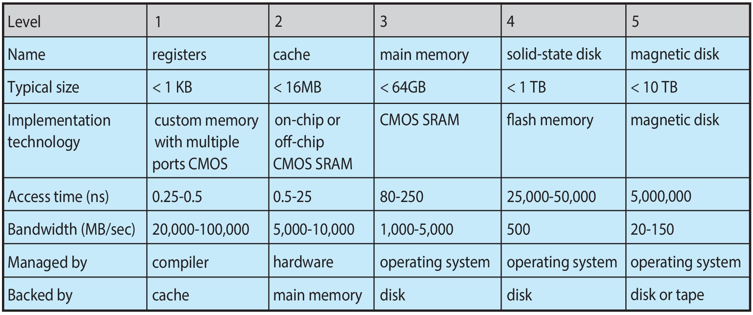
Characteristics of Various Types of Storage
Movement between levels of storage hierarchy can be explicit or implicit

Slide 59
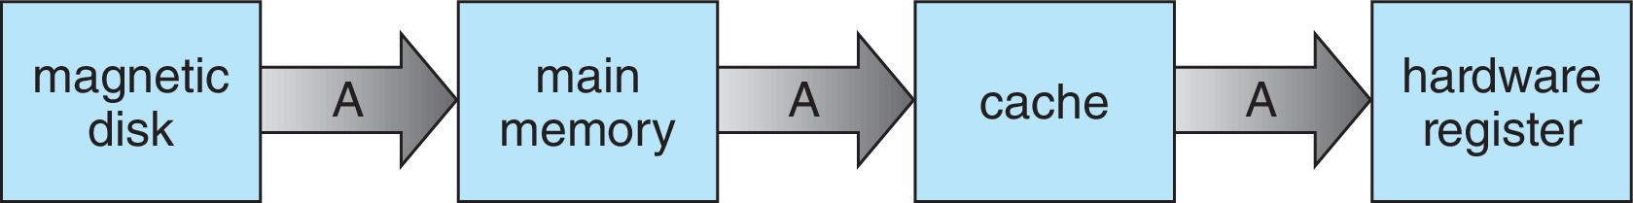
Migration of data “A” from Disk to Register
Multitasking environments must be careful to use most recent value, no matter where it is stored in the storage hierarchy
Multiprocessor environment must provide cache coherency in hardware such that all CPUs have the most recent value in their cache
Distributed environment situation even more complex
Several copies of a datum can exist
Various solutions covered in Chapter 19
Notes:
-محیط چند پردازنده باید انسجام کش را در سخت افزار فراهم کند به طوری که همه CPU ها آخرین مقدار را در حافظه پنهان خود داشته باشند.

Slide 60
Migration of data “A” from Disk to Register
Cache coherency is a consistency mechanism for ensuring that all CPUs in a multiprocessor system observe a single, consistent view of the data.
When one CPU updates a location in its cache, the corresponding location in other caches must be updated or invalidated to maintain coherency.
two processors, P1 and P2, that have their own caches and are both trying to access a memory location M.
P1 Cache: M=10; P2 Cache: M=10 ; Main Memory: M=10
Now, P1 changes the value of M to 20 in its cache. Without a cache coherency protocol, P2 would still see the old value of M (10) in its cache.
With a cache coherency protocol in place, when P1 changes the value of M in its cache, the change is propagated to the main memory and P2’s cache. So, P2 sees the updated value of M (20).
Notes:
ترتیب حافظه (Cache Coherency) یک مکانیزم همگام‌سازی است که اطمینان می‌دهد تمام واحدهای پردازش مرکزی (CPU) در یک سیستم چند پردازنده، یک نمای واحد و سازگار از داده‌ها را مشاهده کنند.
هنگامی که یک CPU موقعیتی را در حافظه کش خود به روز می‌کند، موقعیت مربوطه در سایر حافظه‌های کش باید به روز شود یا باطل شود تا همگام‌سازی حفظ شود.
مثال: فرض کنید دو پردازنده P1 و P2 وجود دارند که هر کدام حافظه کش خود را دارند و هر دو در تلاش برای دسترسی به یک موقعیت حافظه M هستند. در ابتدا، هر دو P1 و P2 مقدار M را در حافظه کش خود بارگذاری می کنند. فرض کنید مقدار M برابر با 10 است.
حافظه کش P1: M=10; حافظه کش P2: M=10; حافظه اصلی: M=10
اکنون، P1 مقدار M را در حافظه کش خود به 20 تغییر می دهد. بدون پروتکل همگام‌سازی حافظه، P2 همچنان مقدار قدیمی M (10) را در حافظه کش خود مشاهده می کند.
با وجود یک پروتکل همگام‌سازی حافظه، هنگامی که P1 مقدار M را در حافظه کش خود تغییر می دهد، این تغییر به حافظه اصلی و حافظه کش P2 منتقل می شود. بنابراین، P2 مقدار به روز شده M (20) را می بیند.

Slide 61
I/O Subsystem
One purpose of OS is to hide peculiarities of hardware devices from the user
I/O subsystem responsible for
Memory management of I/O including buffering (storing data temporarily while it is being transferred), caching (storing parts of data in faster storage for performance), spooling (the overlapping of output of one job with input of other jobs)
General device-driver interface
Drivers for specific hardware devices
Notes:
یکی از اهداف سیستم عامل (OS) پنهان کردن ویژگی های خاص دستگاه های سخت افزاری از کاربر است.
زیرسیستم ورودی/خروجی (I/O) مسئول موارد زیر است:
مدیریت حافظه برای I/O: شامل بافرینگ (ذخیره موقت داده ها در حین انتقال)، کش (ذخیره بخشی از داده ها در حافظه سریع‌تر برای افزایش عملکرد) و اسپولینگ (همپوشانی خروجی یک کار با ورودی کارهای دیگر).
رابط عمومی درایور دستگاه: رابط مشترکی که تمام درایورهای دستگاه از آن پیروی می کنند.
درایور دستگاه های سخت افزاری خاص: نرم افزارهای خاصی که نحوه تعامل سیستم عامل با یک دستگاه سخت افزاری خاص را مدیریت می کنند.
How spooling works:
Imagine a scenario where a faster device (such as the CPU) needs to send data to a slower device (like a printer) for some operation.
Instead of waiting for the slower device to process the data immediately, spooling creates a buffer called SPOOL.
This SPOOL holds off jobs and data until the slower device is ready to use and execute the job or operate on the data.
The faster device uses any additional auxiliary memory (such as secondary storage) as the SPOOL buffer.
When the slower device is ready, the input data stored in the SPOOL is loaded into main memory for the required operations.
Multiple input devices can connect to a single device, and each input device may store its data in the SPOOL.
This prevents the CPU from becoming idle, ensuring continuous processing

Slide 62
Protection and Security
Protection – any mechanism for controlling access of processes or users to resources defined by the OS
Security – defense of the system against internal and external attacks
Huge range, including denial-of-service, worms, viruses, identity theft, theft of service

Slide 63
Protection and Security
Systems generally first distinguish among users, to determine who can do what
User identities (user IDs, security IDs) include name and associated number, one per user
User ID then associated with all files, processes of that user to determine access control
Group identifier (group ID) allows set of users to be defined and controls managed, then also associated with each process, file
Privilege escalation allows user to change to effective ID with more rights
Notes:
افزایش امتیاز به کاربر اجازه می دهد تا به شناسه موثر با حقوق بیشتر تغییر کند
سیستم‌ها به طور کلی ابتدا بین کاربران تمایز قائل می‌شوند تا تعیین کنند چه کسی به چه چیزی دسترسی دارد.
شناسه‌های کاربری (شناسه کاربری، شناسه‌های امنیتی) شامل نام و شماره مرتبط، برای هر کاربر یک مورد است.
سپس شناسه کاربری با تمام فایل‌ها و فرآیندهای آن کاربر مرتبط می‌شود تا کنترل دسترسی تعیین شود.
شناسه گروه (شناسه گروه) به تعریف مجموعه ای از کاربران و مدیریت کنترل ها اجازه می دهد، سپس با هر فرآیند و فایل نیز مرتبط می شود.
تصاعد امتیاز (Privilege escalation) به کاربر اجازه می دهد تا به شناسه موثر با حقوق بیشتر تغییر کند.

Slide 64
Virtualization
Allows operating systems to run applications within other OSes
Vast and growing industry
Emulation used when source CPU type different from target type (i.e. PowerPC to Intel x86)
Generally slowest method
When computer language not compiled to native code – Interpretation
Virtualization – OS natively compiled for CPU, running guest OSes also natively compiled
Consider VMware running WinXP guests, each running applications, all on native WinXP host OS
VMM (virtual machine Manager) provides virtualization services
Notes:
شبیه‌سازی (Emulation): به عنوان مثال، اگر برنامه‌ای دارید که برای پردازنده‌های PowerPC نوشته شده باشد و بخواهید آن را روی یک پردازنده‌ Intel x86 اجرا کنید، از یک شبیه‌ساز استفاده می‌کنید. شبیه‌ساز سخت‌افزار اصلی (در این مورد، PowerPC) را روی سخت‌افزار مقصد (Intel x86) شبیه‌سازی می‌کند. با این حال، از آنجایی که شامل شبیه‌سازی کل سخت‌افزار می‌شود، به طور کلی کندترین روش است. هزینه بیشتری نسبت به مجازی سازی دارد.
ترجمان (Interpretation): این روش زمانی استفاده می‌شود که یک زبان کامپیوتری به کد بومی کامپایل نشده باشد. یک مفسر دستورالعمل‌های سطح بالا را به یک فرم میانی ترجمه می‌کند و سپس آن را اجرا می‌نماید. برخلاف یک کامپایلر که کل برنامه را قبل از اجرا ترجمه می‌کند، یک مفسر، برنامه را در حین اجرا ترجمه می‌کند که می‌تواند کندتر باشد اما انعطاف‌پذیری بیشتری را ارائه می‌دهد.
-فرض کنید یک برنامه پایتون نوشته‌اید که می‌خواهید آن را اجرا کنید، اما پایتون روی سیستم شما نصب نیست. در این حالت، یک مفسر پایتون دانلود می‌کنید که کد پایتون شما را خط به خط می‌خواند، آن را به کد ماشین قابل فهم برای پردازنده شما ترجمه می‌کند، و سپس آن را اجرا می‌کند.
مفسر پایتون کل برنامه شما را قبل از اجرا ترجمه نمی‌کند، بلکه هر خط را در حین اجرا ترجمه و اجرا می‌کند. این موضوع باعث می‌شود که برنامه‌های پایتون نسبت به برنامه‌های کامپایل‌شده کمی کندتر اجرا شوند، اما در عوض انعطاف‌پذیری بیشتری را ارائه می‌دهد. به عنوان مثال، می‌توانید کد را در حین اجرا تغییر دهید و مفسر بلافاصله تغییرات را اعمال می‌کند.
مجازی‌سازی (Virtualization): این فناوری به شما امکان می‌دهد تا چندین سیستم عامل را روی همان سخت‌افزار فیزیکی اجرا کنید. در این حالت، سیستم‌عامل به‌طور بومی برای CPU کامپایل شده است و سیستم‌عامل‌های مهمان دیگری را اجرا می‌کند که آن‌ها نیز به‌طور بومی کامپایل شده‌اند. به عنوان مثال، فرض کنید نرم‌افزار VMware در حال اجرای سیستم‌عامل مهمان ویندوز XP است. هر سیستم‌عامل مهمان در حال اجرای برنامه‌های کاربردی خود، همگی روی یک سیستم‌عامل میزبان ویندوز XP به‌صورت بومی اجرا می‌شوند.
مدیر ماشین مجازی (VMM): این نرم‌افزار مسئول مدیریت منابع سیستم است به گونه‌ای که هر سیستم‌عامل مهمان اعتقاد دارد که کنترل انحصاری روی سخت‌افزار دارد، در حالی که در واقع سخت‌افزار بین مهمان‌های متعدد به اشتراک گذاشته می‌شود.

Slide 65
Virtualization (cont.)
Use cases involve laptops and desktops running multiple OSes for exploration or compatibility
Apple laptop running Mac OS X host, Windows as a guest
Developing apps for multiple OSes without having multiple systems
Quality assurance testing applications without having multiple systems
Executing and managing compute environments within data centers
VMM can run natively, in which case they are also the host
There is no general-purpose host then (VMware ESX and Citrix XenServer)

Slide 66
Computing Environments - Virtualization
Notes:
The VMM runs the guest operating systems, manages their resource use, and protects each guest from the others.

Slide 67
Distributed Systems
Distributed computing
Collection of separate, possibly heterogeneous, systems networked together
Network is a communications path, TCP/IP most common
Network Operating System provides features between systems across the network
Communication scheme allows systems to exchange messages
Illusion of a single system
Notes:
یک کامپیوتر که روی آن یک سیستم عامل شبکه‌ای اجرا می‌شود، علی‌رغم آگاهی از شبکه و توانایی برقراری ارتباط با سایر کامپیوترهای شبکه، به طور مستقل از سایر کامپیوترهای شبکه عمل می‌کند. در مقابل، یک سیستم عامل توزیع شده، محیطی با خودمختاری کم‌تر را فراهم می‌کند. کامپیوترهای مختلف در این سیستم به ‌اندازه‌ی کافی با هم ارتباط برقرار می‌کنند تا این توهم را ایجاد کنند که تنها یک سیستم عامل کل شبکه را کنترل می‌کند.

Slide 68
Network Operating System VS Distributed Systems
Windows Server: A popular network operating system that allows centralized management of network resources like files, printers, and users. Computers on the network operate independently but can connect to the Windows server to access resources.
Android OS: A distributed operating system that runs on smartphones and tablets. It communicates with other components of the operating system on other networked devices like smartwatches and smart speakers. This communication creates the illusion of a single operating system for the end user, while in reality, various tasks are distributed across different devices.
Notes:
یک کامپیوتر که روی آن یک سیستم عامل شبکه‌ای اجرا می‌شود، علی‌رغم آگاهی از شبکه و توانایی برقراری ارتباط با سایر کامپیوترهای شبکه، به طور مستقل از سایر کامپیوترهای شبکه عمل می‌کند. در مقابل، یک سیستم عامل توزیع شده، محیطی با خودمختاری کم‌تر را فراهم می‌کند. کامپیوترهای مختلف در این سیستم به ‌اندازه‌ی کافی با هم ارتباط برقرار می‌کنند تا این توهم را ایجاد کنند که تنها یک سیستم عامل کل شبکه را کنترل می‌کند.
مثال برای سیستم عامل شبکه (NOS):
ویندوز سرور (Windows Server): یک سیستم عامل شبکه محبوب که امکان مدیریت متمرکز منابع شبکه مانند فایل‌ها، چاپگرها و کاربران را فراهم می‌کند. کامپیوترهای موجود در شبکه به صورت مستقل کار می‌کنند، اما می‌توانند برای دسترسی به منابع به سرور ویندوز متصل شوند.
Example for Distributed Operating System (DOS):
سیستم عامل اندروید (Android OS): یک سیستم عامل توزیع شده که روی گوشی‌های هوشمند و تبلت‌ها اجرا می‌شود. اندروید از هسته لینوکس به عنوان هسته خود استفاده می‌کند، که با سایر اجزا سیستم عامل در سایر دستگاه‌های شبکه مانند ساعت‌های هوشمند و بلندگوهای هوشمند ارتباط برقرار می‌کند. این ارتباط، توهمی از یک سیستم عامل واحد را برای کاربر نهایی ایجاد می‌کند، در حالی که در واقع وظایف مختلف در دستگاه‌های مختلف توزیع شده‌اند.

Slide 69
Computer-System Architecture

Slide 70
Computer-System Architecture
Most systems use a single general-purpose processor
Most systems have special-purpose processors as well
Multiprocessor's systems growing in use and importance
Also known as parallel systems, tightly-coupled systems
Advantages include:
Increased throughput
Economy of scale
Increased reliability – graceful degradation or fault tolerance
Two types:
Asymmetric Multiprocessing (AMP)– each processor is assigned a specie task.
Symmetric Multiprocessing (SMP) – each processor performs all tasks
Notes:
اکثر سیستم‌ها از یک پردازنده‌ مرکزی با کاربری عمومی استفاده می‌کنند.
اکثر سیستم‌ها همچنین پردازنده‌های با کاربری خاص دارند. استفاده از سیستم‌های چند پردازنده‌ای در حال افزایش است و اهمیت بیشتری پیدا می‌کند.
همچنین به عنوان سیستم‌های موازی، سیستم‌های با اتصال نزدیک شناخته می‌شوند.
مزایا عبارتند از: افزایش توان عملیاتی
صرفه جویی در مقیاس
افزایش قابلیت اطمینان – تخریب تدریجی یا تحمل خطا
دو نوع وجود دارد: پردازش غیرمتقارن چند پردازنده‌ای - به هر پردازنده یک کار خاص اختصاص داده می‌شود. پردازش متقارن چند پردازنده‌ای - هر پردازنده تمام وظایف را انجام می‌دهد.

Slide 71
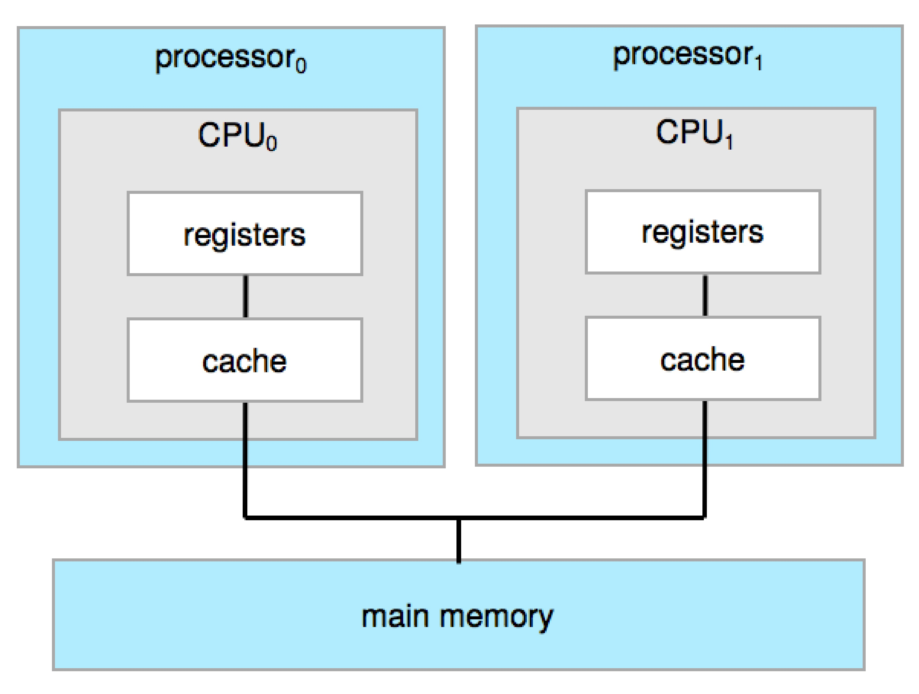
Symmetric Multiprocessing Architecture
Notes:
نمونه‌هایی از پردازش غیرمتقارن چند پردازنده‌ای (AMP) و پردازش متقارن چند پردازنده‌ای (SMP)
پردازش غیرمتقارن چند پردازنده‌ای (AMP):
فرض کنید یک دستگاه چاپگر شبکه‌ای دارید که علاوه بر چاپ وظایف ارسال‌شده از رایانه‌های مختلف، داده‌ها را از اسکنر متصل نیز پردازش می‌کند. در این سناریو:
پردازنده اصلی (CPU): وظایف عمومی سیستم عامل مانند مدیریت حافظه و مدیریت شبکه را مدیریت می‌کند.
پردازنده اختصاصی: وظایف چاپ و اسکن را پردازش می‌کند.
در این مثال، پردازنده اصلی وظایف کلی سیستم را مدیریت می‌کند در حالی که پردازنده خاص بر روی کارهای ورودی/خروجی چاپ و اسکن تمرکز دارد.
پردازش متقارن چند پردازنده‌ای (SMP):
فرض کنید یک سرور وب دارید که چندین وب‌سایت را میزبانی می‌کند. در این سناریو:
چندین پردازنده (CPU) وجود دارد که همه به طور مساوی در پردازش درخواست‌های وب ورودی از کاربران مختلف و همچنین سایر وظایف مرتبط با سرور مانند مدیریت پایگاه داده و ارسال ایمیل مشارکت می‌کنند.
در این مثال، تمام پردازنده‌ها می‌توانند هر وظیفه‌ای را که به سرور ارسال می‌شود، از جمله پردازش درخواست‌های وب، مدیریت پایگاه داده یا هر کار دیگری که نیاز به محاسبات دارد، انجام دهند.
تفاوت کلیدی:
تفاوت اصلی بین AMP و SMP در نحوه تخصیص وظایف به پردازنده‌ها است. در AMP، هر پردازنده یک مجموعه خاص از وظایف را بر عهده می گیرد، در حالی که در SMP، همه پردازنده ها می توانند هر وظیفه ای را انجام دهند.

Slide 72
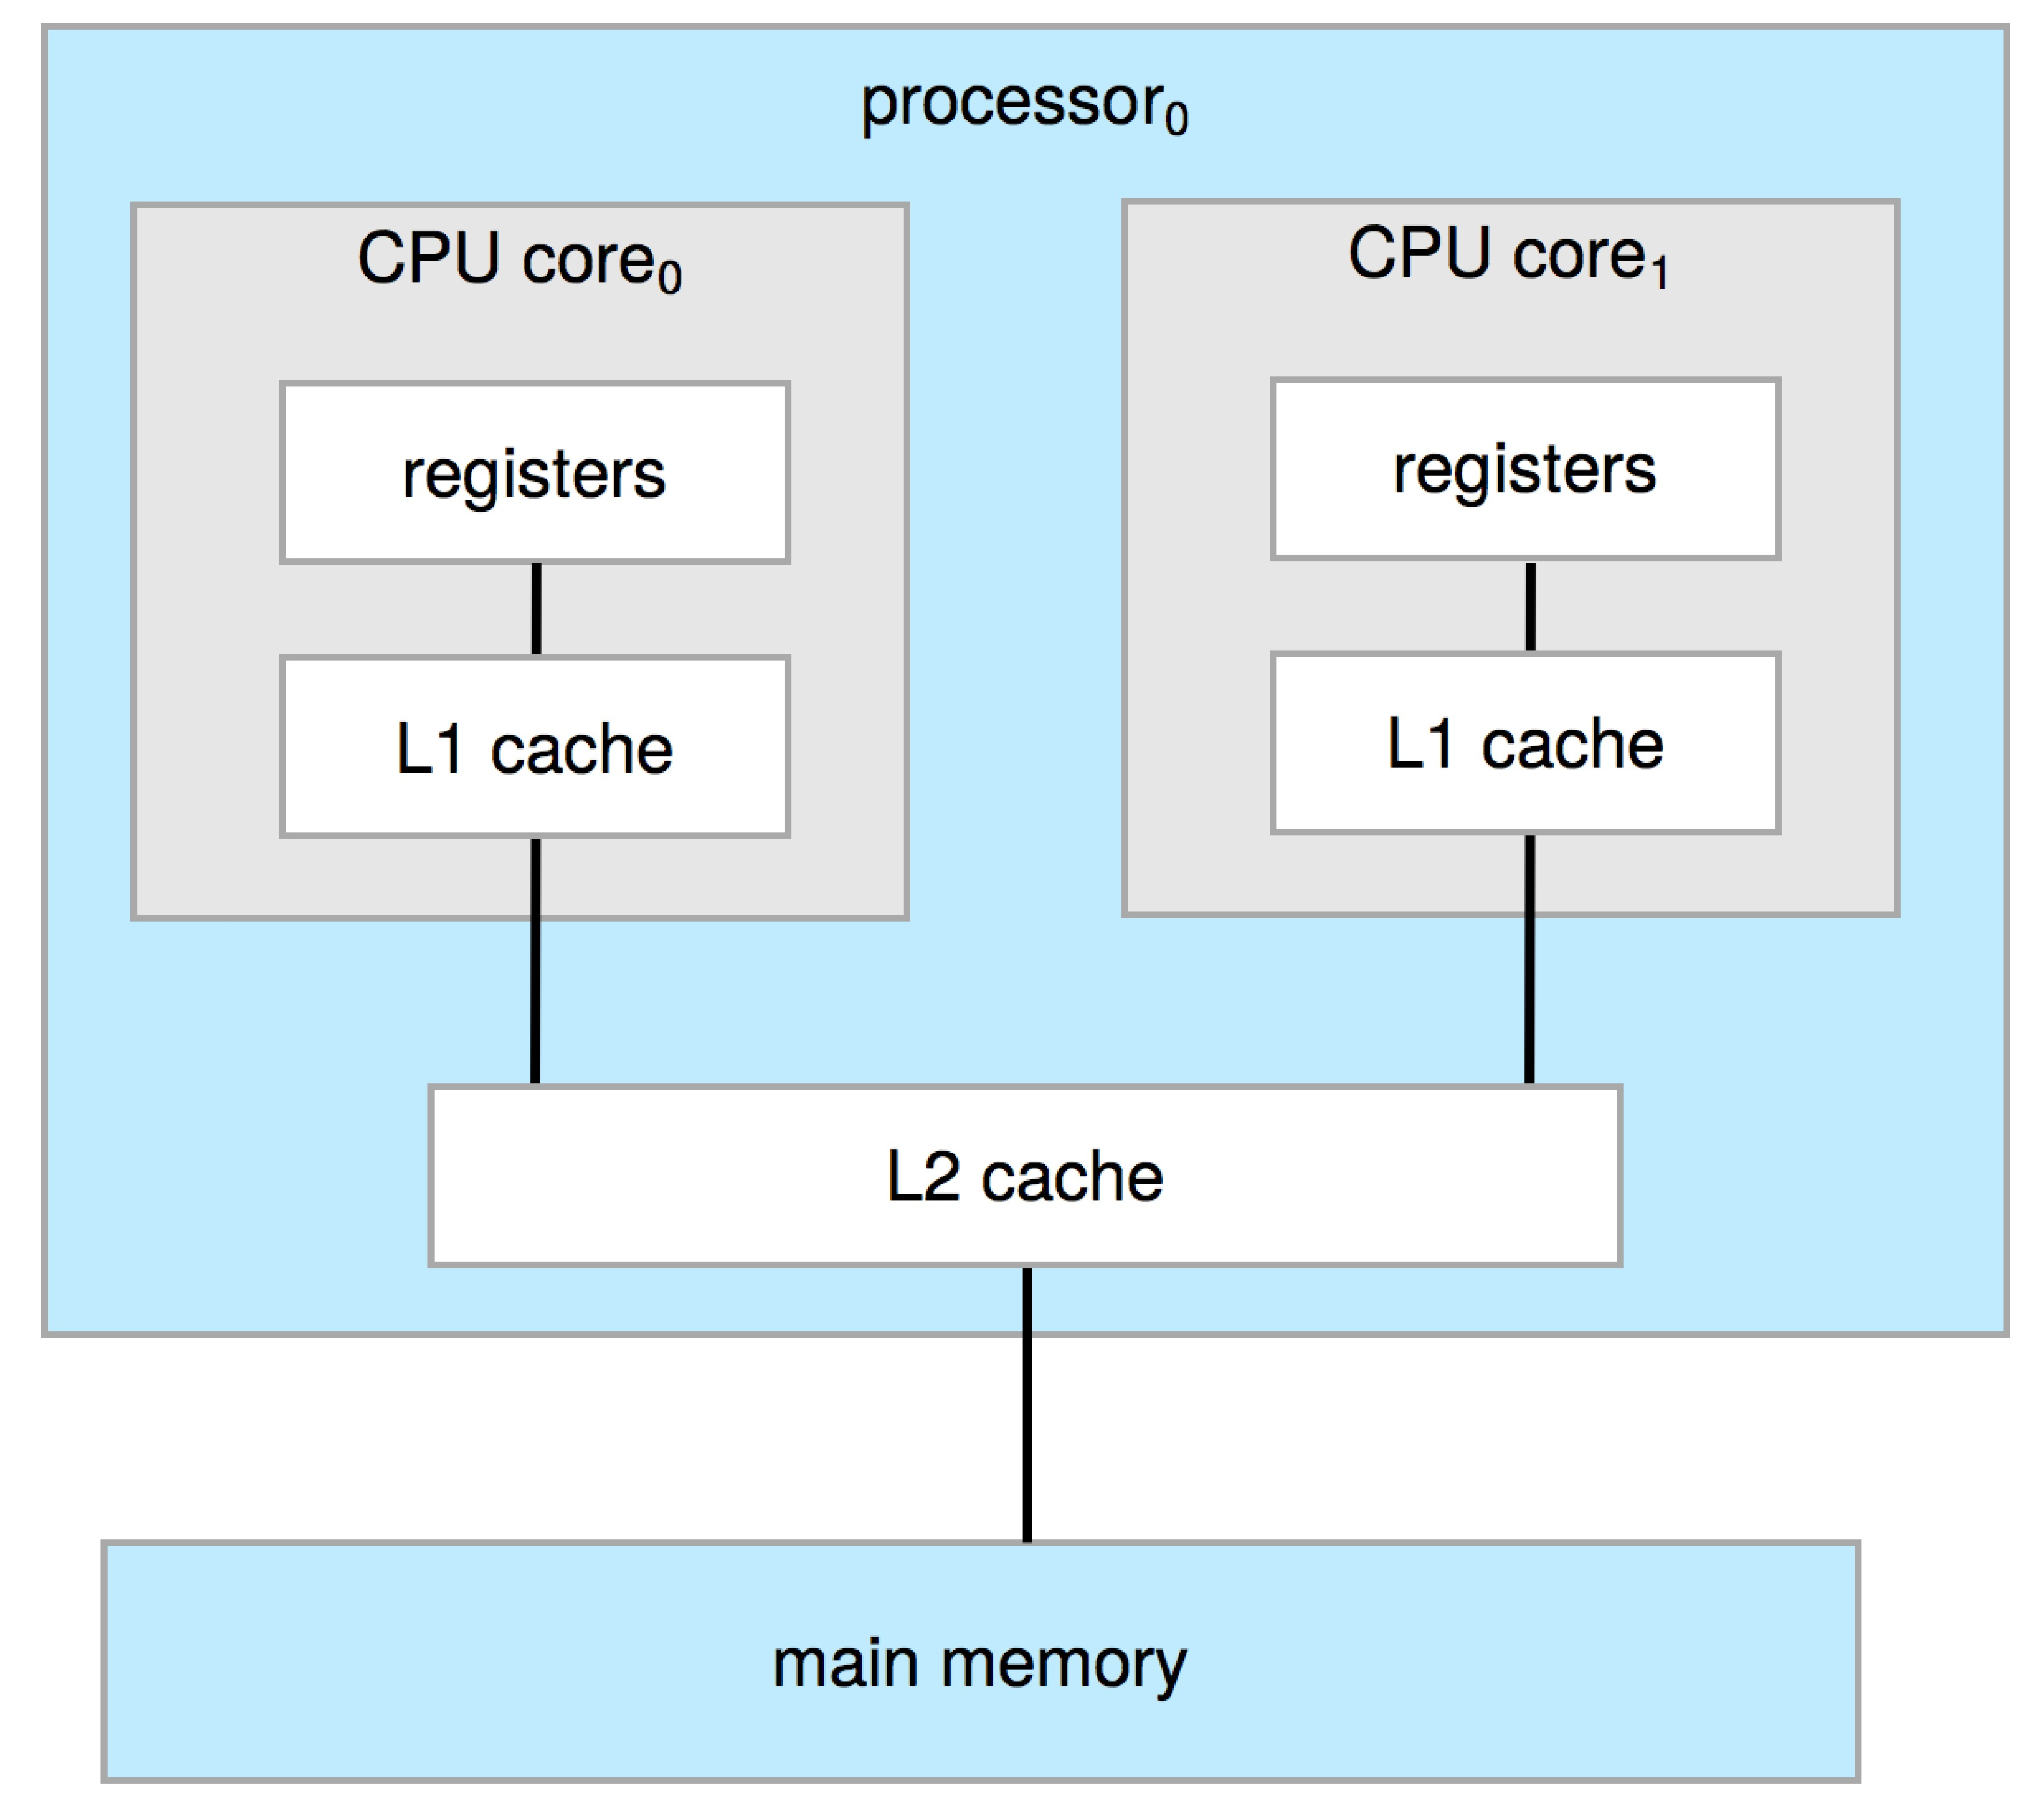
Dual-Core Design
Multi-chip and multicore
Systems containing all chips
Chassis containing multiple separate systems

Slide 73
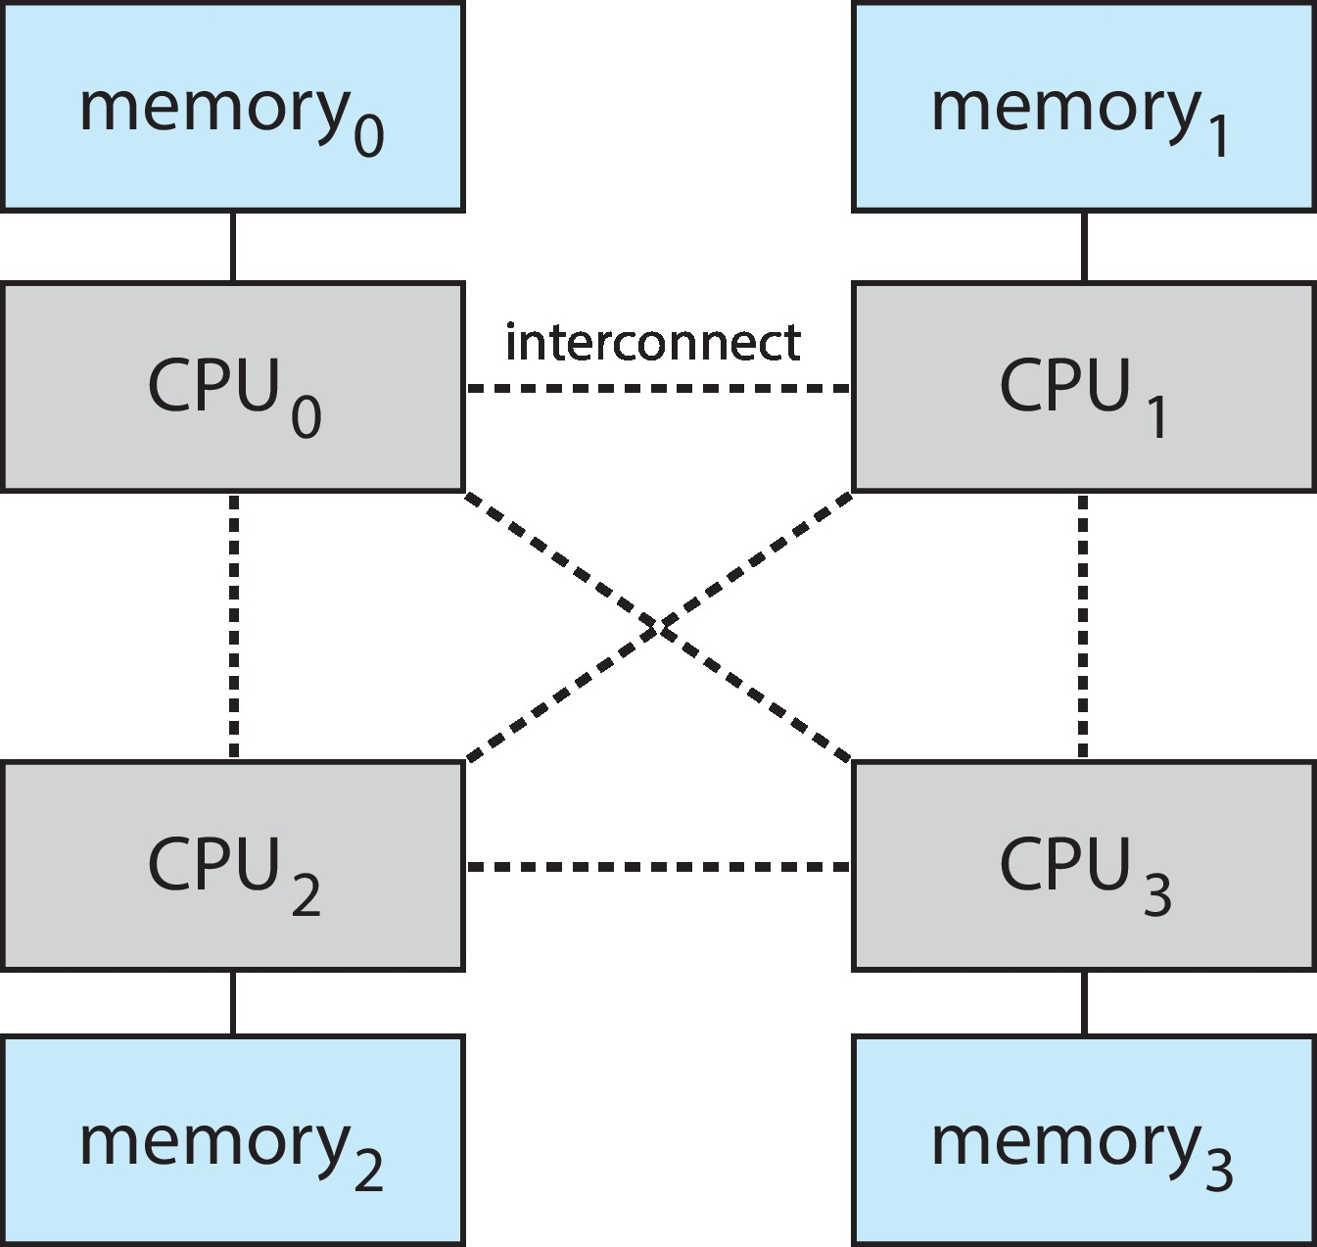
Non-Uniform Memory Access System
Notes:
Memory Partitioning: The system divides memory into multiple memory banks.
Local vs. Non-local Access:
A processor can access its own local memory with lower latency.
Accessing memory assigned to other processors incurs higher latency.
Resource Sharing: Processors work together, sharing local memory, to improve overall performance.
Scalability: NUMA scales well for large systems with multiple processors

Slide 74
Clustered Systems
Like multiprocessor systems, but multiple systems working together
Usually sharing storage via a storage-area network (SAN)
Provides a high-availability service which survives failures
Asymmetric clustering has one machine in hot-standby mode
Symmetric clustering has multiple nodes running applications, monitoring each other
Some clusters are for high-performance computing (HPC)
Applications must be written to use parallelization
Some have distributed lock manager (DLM) to avoid conflicting operations
Notes:
Asymmetric Clustering:
Definition: In an asymmetric clustering system, one of the nodes in the cluster operates in hot standby mode, while the other nodes actively run the required applications.
Hot Standby Node: The hot standby node continuously monitors the server. If the active server fails, the hot standby node seamlessly takes its place.
Working Mechanism:
The master node in asymmetric clustering directs all the slave nodes to perform tasks.
Requests are delegated by the master node.
A distributed cache is used to enhance system performance.
Resources (such as memory and peripheral devices) are divided among nodes during boot time.
Advantages:
Cost Reduction: Since multiple computer systems are connected, the cost of separate peripheral devices and memory is reduced.
Increased Reliability: Even if one node fails, others can continue processing.
Independence: Each node has its own kernel and can operate on different operating systems.
Inter-Process Communication: Processors share memory only for inter-process communication¹.
Symmetric Clustering:
Definition: In symmetric clustering, two or more nodes actively run applications and monitor each other simultaneously.
Efficiency: Symmetric clustering efficiently utilizes all hardware resources without keeping any node solely as a hot standby.
خوشه‌بندی (Clustering): مشابه سیستم‌های چند پردازنده‌ای، اما با چندین سیستم که با هم کار می‌کنند.
معمولا از طریق یک شبکه ذخیره‌سازی (SAN) به اشتراک گذاری ذخیره‌سازی می‌پردازند.
خدمات با دسترسی بالا را ارائه می‌دهد که در برابر خرابی‌ها مقاوم است.
خوشه‌بندی نامتقارن یک ماشین را در حالت آماده به کار داغ (hot-standby) دارد.
خوشه‌بندی متقارن چندین گره (node) دارد که برنامه‌ها را اجرا می‌کنند و بر یکدیگر نظارت دارند.
برخی از خوشه‌ها برای محاسبات با عملکرد بالا (HPC) هستند.
برنامه‌ها باید برای استفاده از موازی‌سازی نوشته شوند.
برخی دارای مدیریت‌کننده قفل توزیع‌شده (DLM) برای جلوگیری از عملیات متضاد هستند.

Slide 75
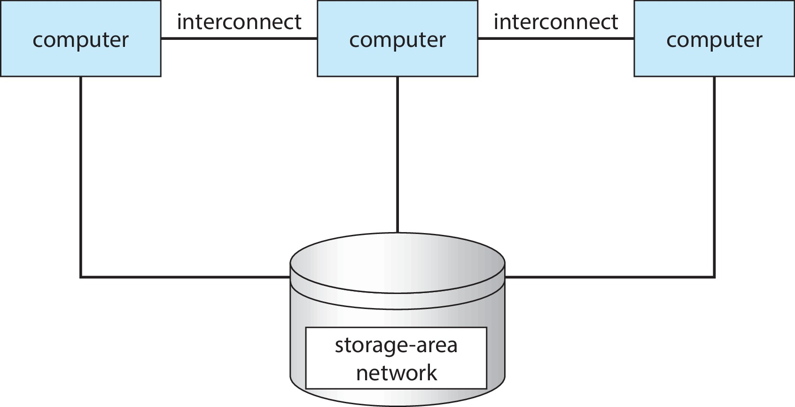
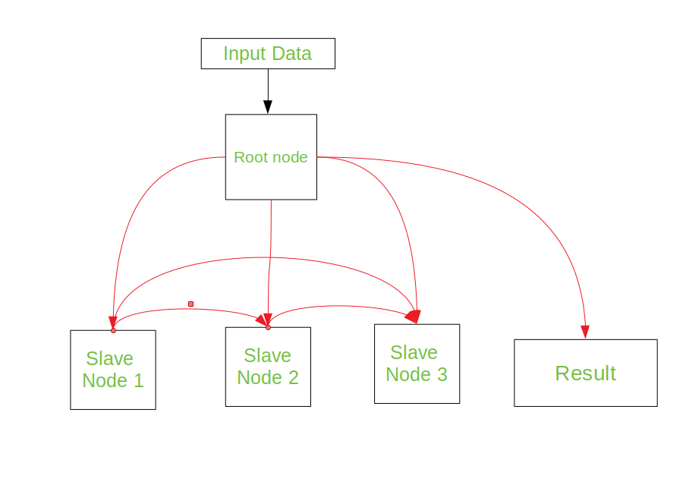
Clustered Systems

Slide 76
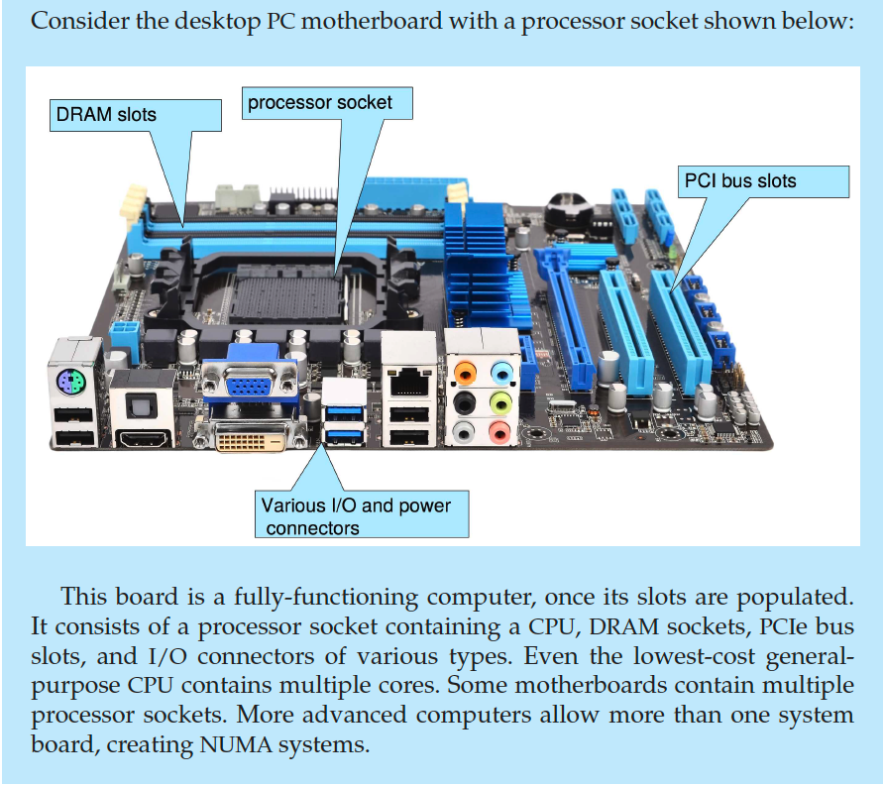
PC Motherboard
Notes:
این برد، پس از پر شدن اسلات‌هایش، یک کامپیوتر کاملا کاربردی است. این برد از یک سوکت پردازنده حاوی CPU، سوکت‌های DRAM، اسلات‌های باس PCIe و کانکتورهای I/O از انواع مختلف تشکیل شده است. حتی کم‌هزینه‌ترین CPU های عمومی نیز دارای چندین هسته هستند. برخی از مادربردها دارای چندین سوکت پردازنده هستند. کامپیوترهای پیشرفته‌تر امکان استفاده از بیش از یک برد سیستم را فراهم می‌کنند و سیستم‌های NUMA را ایجاد می‌کنند.
A PCI slot is a built-in slot on a device that allows for the attachment of various hardware components such as network cards, modems, sound cards, disk controllers and other peripherals

Slide 77
Computer System Environments

Slide 78
Computing Environments
Traditional
Mobile
Client Server
Pear-to-Pear
Cloud computing
Real-time Embedded

Slide 79
Mobile Computing
Handheld smartphones, tablets, etc.
What is the functional difference between them and a “traditional” laptop?
Extra feature – more OS features (GPS, gyroscope)
Allows new types of apps like augmented reality
Use IEEE 802.11 wireless, or cellular data networks for connectivity
Leaders are Apple iOS and Google Android

Slide 80
Client Server Computing
Dumb terminals supplanted by smart PCs
Many systems now servers, responding to requests generated by clients
Compute-server system provides an interface to client to request services (i.e., database)
File-server system provides interface for clients to store and retrieve files
Notes:
پایانه‌های مبتدی توسط رایانه‌های شخصی هوشمند جایگزین شدند
در گذشته، رایانه‌های رومیزی عمدتاً به عنوان پایانه‌های "مبتدی" عمل می‌کردند و توانایی پردازش محدودی داشتند. این پایانه‌ها با کامپیوترهای شخصی (PCs) قدرتمندتر جایگزین شدند که می توانند طیف وسیعی از وظایف را به طور مستقل انجام دهند.
بسیاری از سیستم‌ها اکنون به سرور تبدیل شده‌اند که به درخواست‌های ایجاد شده توسط مشتریان پاسخ می‌دهند
در دنیای مدرن، بسیاری از سیستم‌های کامپیوتری دیگر صرفاً برای محاسبات شخصی استفاده نمی‌شوند، بلکه به عنوان سرور عمل می‌کنند. سرور رایانه‌ای است که منابع مانند داده‌ها، برنامه‌ها و خدمات را در اختیار سایر رایانه‌ها (به نام مشتری) قرار می‌دهد.
سیستم سرور محاسباتی رابطه‌ای را برای مشتریان جهت درخواست خدمات (مانند پایگاه داده) فراهم می‌کند
یکی از انواع رایج سرور، سرور محاسبات است که به مشتریان اجازه می‌دهد تا از قدرت پردازش سرور برای انجام محاسبات پیچیده استفاده کنند. به عنوان مثال، یک شرکت طراحی ممکن است از سرور محاسبات برای رندر کردن تصاویر سه بعدی پیچیده استفاده کند.
سیستم سرور فایل رابطه‌ای را برای ذخیره و بازیابی فایل‌ها توسط مشتریان فراهم می‌کند
نوع دیگری از سرور، سرور فایل است که به چندین کاربر اجازه می‌دهد تا فایل‌ها را به طور مرکزی ذخیره و به اشتراک بگذارند. این امر دسترسی به فایل‌ها را برای همه کاربران آسان‌تر می‌کند و اطمینان می‌دهد که همه از آخرین نسخه فایل‌ها استفاده می‌کنند.

Slide 81
Peer-to-Peer
Another model of distributed system
P2P does not distinguish clients and servers
Instead all nodes are considered peers
May each act as client, server or both
Node must join P2P network
Registers its service with central lookup service on network, or
Broadcast request for service and respond to requests for service via discovery protocol
Examples include Napster and Gnutella, Voice over IP (VoIP) such as Skype
Notes:
مدل دیگری از سیستم توزیع‌شده
یک مدل رایج دیگر از سیستم‌های توزیع‌شده، سیستم‌های همتا به همتا (P2P) می‌باشد. این سیستم‌ها با مدل سنتی سرور-مشتری که در متن قبلی توضیح داده شد، متفاوت هستند.
شبکه‌های P2P بین سرویس‌گیرندگان و مشتریان تمایز قائل نمی‌شوند
برخلاف مدل سنتی سرور-مشتری که در آن رایانه‌ها به دو دسته سرور و مشتری تقسیم می‌شوند، در P2P، همه گره‌ها (nodes) به عنوان همتا در نظر گرفته می‌شوند. هر گره در شبکه P2P می‌تواند:
به عنوان مشتری عمل کند: و از منابع (مانند فایل‌ها، برنامه‌ها یا خدمات) ارائه شده توسط سایر گره‌ها در شبکه استفاده کند.
به عنوان سرور عمل کند: و منابع خود را در اختیار سایر گره‌های شبکه قرار دهد.
به‌طور همزمان هم به عنوان مشتری و هم به عنوان سرور عمل کند: به این معنی که می‌تواند هم از منابع دیگران استفاده کند و هم منابع خود را به اشتراک بگذارد.
گره‌ها برای پیوستن به شبکه P2P نیاز به ثبت‌نام دارند
هنگامی که یک گره جدید می‌خواهد به شبکه P2P بپیوندد، باید این فرآیند را طی کند:
ثبت سرویس با سرویس جستجوی مرکزی: این سرویس به گره‌ها کمک می‌کند تا سایر گره‌هایی را که منابع مورد نظر آن‌ها را ارائه می‌دهند، پیدا کنند.
پخش درخواست برای سرویس و پاسخ به درخواست‌های سرویس از طریق پروتکل کشف: در این روش، گره مستقیماً به همه گره‌های دیگر در شبکه اعلام می‌کند که به دنبال یک سرویس خاص است و همچنین به درخواست‌های سایر گره‌ها برای خدماتی که ارائه می‌دهد پاسخ می‌دهد.
نمونه‌هایی از شبکه‌های P2P:
اشتراک‌گذاری فایل: شبکه‌های P2P برای اشتراک‌گذاری فایل‌های موسیقی، فیلم و سایر فایل‌ها محبوب هستند. نمونه‌های اولیه این شبکه‌ها مانند Napster و Gnutella، بر اساس این مدل عمل می‌کردند.
صدا روی پروتکل اینترنت (VoIP): برنامه‌های VoIP مانند Skype از شبکه‌های P2P برای برقراری تماس‌های صوتی و تصویری مستقیم بین کاربران استفاده می‌کنند.
اطلاعات اضافی:
گره (node): هر رایانه یا دستگاهی که بخشی از شبکه P2P است، یک گره در نظر گرفته می‌شود.
پروتکل کشف (discovery protocol): مجموعه‌ای از قوانین است که گره‌ها در شبکه P2P برای یافتن یکدیگر و منابع مورد نیاز خود استفاده می‌کنند.

Slide 82
Cloud Computing
Delivers computing, storage, even apps as a service across a network
Logical extension of virtualization because it uses virtualization as the base for it functionality.
Amazon EC2 has thousands of servers, millions of virtual machines, petabytes of storage available across the Internet, pay based on usage

Slide 83
Cloud Computing – Many Types
Public cloud – available via Internet to anyone willing to pay
Private cloud – run by a company for the company’s own use
Hybrid cloud – includes both public and private cloud components
Software as a Service (SaaS) – one or more applications available via the Internet (i.e., word processor)
Platform as a Service (PaaS) – software stack ready for application use via the Internet (i.e., a database server)
Infrastructure as a Service (IaaS) – servers or storage available over Internet (i.e., storage available for backup use)
Notes:
انواع ابر (Cloud):
ابر عمومی (Public cloud):
در دسترس عموم از طریق اینترنت است و هر کسی با تمایل به پرداخت هزینه می‌تواند از آن استفاده کند.
منابع محاسباتی، ذخیره‌سازی و شبکه توسط یک ارائه دهنده خدمات ابری (Cloud Service Provider یا CSP) مدیریت و به اشتراک گذاشته می‌شود.
نمونه‌هایی از ابر عمومی: Amazon Web Services (AWS), Microsoft Azure, Google Cloud Platform (GCP)
ابر خصوصی (Private cloud):
توسط یک شرکت برای استفاده اختصاصی آن شرکت اجرا می‌شود.
منابع محاسباتی، ذخیره‌سازی و شبکه تحت کنترل کامل شرکت قرار دارد و با سایر سازمان‌ها به اشتراک گذاشته نمی‌شود.
ابر خصوصی می‌تواند امنیت و کنترل بالایی را برای داده‌های حساس سازمان فراهم کند، اما هزینه راه‌اندازی و نگهداری آن نیز بیشتر است.
ابر ترکیبی (Hybrid cloud):
ترکیبی از ابر عمومی و خصوصی است.
یک سازمان می‌تواند از ابر عمومی برای برخی از کارهای خود، مانند محاسبات غیرانتقادی، و از ابر خصوصی برای کارهای حساس‌تر و با نیازهای امنیتی بالاتر استفاده کند.
ابر ترکیبی انعطاف‌پذیری بالایی را ارائه می‌دهد، زیرا به سازمان‌ها اجازه می‌دهد تا از مزایای هر دو نوع ابر استفاده کنند.
مدل‌های خدمات ابری:
نرم‌افزار به عنوان سرویس (SaaS):
مدل SaaS به سازمان‌ها امکان می‌دهد تا به نرم‌افزار و برنامه‌های کاربردی از طریق اینترنت دسترسی داشته باشند.
ارائه دهنده خدمات، نرم‌افزار را بر روی زیرساخت ابری خود مدیریت و نگهداری می‌کند و کاربران نهایی از طریق مرورگر وب یا رابط کاربری دیگر با آن تعامل می‌کنند.
نمونه‌هایی از SaaS: Gmail، Microsoft Office 365، Salesforce
سکوی به عنوان سرویس (PaaS):
مدل PaaS به توسعه‌دهندگان امکان می‌دهد تا نرم‌افزارهای خود را بر روی زیرساخت ابری توسعه، آزمایش، اجرا و مقیاس‌بندی کنند.
ارائه دهنده خدمات، زیرساخت ابری، سیستم عامل، پایگاه داده و سایر ابزارهای مورد نیاز برای توسعه و اجرای نرم‌افزار را فراهم می‌کند، در حالی که توسعه‌دهندگان بر روی توسعه برنامه خود تمرکز می‌کنند.
نمونه‌هایی از PaaS: Microsoft Azure, Google App Engine, Heroku
زیرساخت به عنوان سرویس (IaaS):
مدل IaaS به سازمان‌ها امکان می‌دهد تا به منابع محاسباتی، ذخیره‌سازی و شبکه به صورت برون سپاری شده از طریق اینترنت دسترسی داشته باشند.
سازمان‌ها می‌توانند از این منابع برای راه‌اندازی سیستم‌عامل‌ها، برنامه‌های کاربردی و سایر نرم‌افزارهای مورد نیاز خود استفاده کنند.
مدل IaaS کنترل بیشتری را نسبت به مدل‌های SaaS و PaaS در اختیار سازمان‌ها قرار می‌دهد، اما نیازمند تخصص فنی بیشتری برای مدیریت زیرساخت است.
نمونه‌هایی از IaaS: Amazon Elastic Compute Cloud (EC2), Microsoft Azure Virtual Machines, Google Compute Engine
اطلاعات اضافی:
ارائه دهنده خدمات ابری (Cloud Service Provider یا CSP): شرکتی است که خدمات ابری مانند ابر عمومی، PaaS و IaaS را ارائه می‌دهد.
زیرساخت ابری: ترکیبی از سخت‌افزار، نرم‌افزار، شبکه و سایر منابع است که برای ارائه خدمات ابری مورد نیاز است.

Slide 84
Cloud Computing (cont.)
Cloud computing environments composed of traditional OSes, plus VMMs, plus cloud management tools
Internet connectivity requires security like firewalls
Load balancers spread traffic across multiple applications

Slide 85
Real-Time Embedded Systems
Real-time embedded systems most prevalent form of computers
Vary considerable, special purpose, limited purpose OS, real-time OS
Use expanding
Many other special computing environments as well
Some have OSes, some perform tasks without an OS
Real-time OS has well-defined fixed time constraints
Processing must be done within the constraint
Correct operation only if constraints met
Notes:
سیستم‌های جاسازی‌شده بلادرنگ: رایج‌ترین شکل رایانه‌ها
سیستم‌های جاسازی‌شده (embedded systems) رایج‌ترین شکل رایانه‌ها در دنیای امروز هستند و کاربردهای گسترده‌ای در انواع دستگاه‌های الکترونیکی از جمله:
تلفن‌های همراه
ماشین لباسشویی
چراغ راهنمایی
اسباب‌بازی‌های هوشمند
سیستم‌های کنترل صنعتی
دارند.
انواع سیستم‌های جاسازی‌شده:
سیستم‌های با کاربری خاص (Special purpose systems): این سیستم‌ها برای انجام یک کار خاص طراحی شده‌اند و معمولاٌ از نظر سخت‌افزار و نرم‌افزار محدود هستند.
سیستم‌های با هدف محدود (Limited purpose systems): این سیستم‌ها نیز برای انجام مجموعه‌ای محدود از وظایف طراحی شده‌اند، اما چند منظوره تر از سیستم‌های با کاربری خاص هستند.
انواع سیستم‌عامل‌های مورد استفاده در سیستم‌های جاسازی‌شده:
سیستم‌عامل با کاربری عمومی (General-purpose OS): برخی از سیستم‌های جاسازی‌شده از سیستم‌عامل‌های با کاربری عمومی مشابه با سیستم‌عامل‌های رایانه‌های شخصی استفاده می‌کنند. با این حال، این سیستم‌عامل‌ها معمولاً بهینه‌سازی شده‌اند و برای استفاده در سیستم‌های با منابع محدود، سبک‌تر و کارآمدتر شده‌اند.
سیستم‌عامل با کاربرد خاص (Special-purpose OS): برخی دیگر از سیستم‌های جاسازی‌شده از سیستم‌عامل‌های ساخته شده به صورت اختصاصی برای آن سیستم خاص استفاده می‌کنند. این سیستم‌عامل‌ها برای برآورده کردن نیازهای عملکردی و محدودیت‌های سیستم طراحی شده‌اند.
استفاده در حال گسترش:
استفاده از سیستم‌های جاسازی‌شده به طور مداوم در حال گسترش است و انتظار می‌رود نقش مهمی در آینده "اینترنت اشیا" (IoT) داشته باشد.
محیط‌های محاسباتی خاص دیگر:
علاوه بر سیستم‌های جاسازی‌شده، محیط‌های محاسباتی خاص دیگری نیز وجود دارند که ممکن است از سیستم‌عامل استفاده کنند یا بدون سیستم‌عامل کار کنند. برخی از این محیط‌ها عبارتند از:
میکروکنترلرها (Microcontrollers): دستگاه‌هایی با قابلیت پردازش و ذخیره‌سازی محدود که در بسیاری از دستگاه‌های الکترونیکی ساده استفاده می‌شوند.
کنترل‌کننده‌های منطقی قابل برنامه‌ریزی (PLCs): دستگاه‌هایی که برای کنترل فرآیندهای صنعتی و اتوماسیون استفاده می‌شوند.
ویژگی‌های کلیدی سیستم‌عامل بلادرنگ:
یک ویژگی کلیدی سیستم‌عامل بلادرنگ (Real-time OS) داشتن محدودیت‌های زمانی ثابت و کاملاً تعریف شده (well-defined fixed time constraints) است. این به این معنی است که سیستم‌عامل تضمین می‌کند که پردازش (processing) رویدادها یا داده‌ها درون محدودیت‌های زمانی مشخص (within constraint) انجام شود.
اهمیت برآورده کردن محدودیت‌های زمانی:
عملکرد صحیح (correct operation) سیستم تنها در صورتی تضمین می‌شود که محدودیت‌های زمانی برآورده شوند. عدم رعایت این محدودیت‌ها می‌تواند منجر به نتایج نادرست یا رفتار غیرقابل پیش‌بینی سیستم شود، که در برخی موارد می‌تواند عواقب جدی داشته باشد.

Slide 86
Free and Open-Source Operating Systems
Operating systems made available in source-code format rather than just binary closed-source and proprietary
Counter to the copy protection and Digital Rights Management (DRM) movement
Started by Free Software Foundation (FSF) by Richard Stallman, which has “copyleft” GNU Public License (GPL)
Free software and open-source software are two different ideas championed by different groups of people
http://gnu.org/philosophy/open-source-misses-the-point.html/
Notes:
نرم‌افزارهای منبع‌باز (Open-source software) نرم‌افزارهایی هستند که کد منبع آن‌ها در دسترس عموم قرار دارد. این بدان معناست که هر کسی می‌تواند کد منبع را مشاهده، مطالعه، تغییر، و توزیع کند.
مخالف با محدودیت‌های کپی و مدیریت حقوق دیجیتال (DRM):
جنبش نرم‌افزار منبع‌باز با جنبش محدودیت‌های کپی و مدیریت حقوق دیجیتال (DRM) که هدف آن محدود کردن استفاده و توزیع نرم‌افزار است، مخالف است.
تاریخچه:
جنبش نرم‌افزار آزاد و منبع‌باز ریشه در ایده "نرم‌افزار آزاد" دارد که توسط بنیاد نرم‌افزار آزاد (FSF) با پیشگامی ریچارد استالمن ترویج شده است.
بنیاد FSF مجوز عمومی همگانی گنو (GNU General Public License - GPL) را با مدل کپی‌چپ (copyleft) ارائه داده است که به کاربران آزادی استفاده، تغییر و توزیع نرم‌افزار را می‌دهد، اما همچنین آن‌ها را ملزم می‌کند تا هر نسخه‌ای از نرم‌افزار را تحت همان مجوز منتشر کنند.
لازم به ذکر است که نرم‌افزار آزاد و نرم‌افزار منبع‌باز دو مفهوم کاملاً هم‌پوشانی ندارند و توسط افراد با دیدگاه‌های کمی متفاوت ترویج می‌شوند (برای درک کامل تفاوت این دو مفهوم، به مقاله‌ی "فلسفه گنو: منبع‌باز هدف را گم می‌کند" در وبسایت بنیاد FSF مراجعه کنید: http://gnu.org/philosophy/open-source-misses-the-point.html/).

Slide 87
Free and Open-Source Operating Systems
Examples include GNU/Linux and BSD UNIX (including core of Mac OS X), and many more
Can use VMM like VMware Player (Free on Windows), Virtualbox (open source and free on many platforms - http://www.virtualbox.com)
Use to run guest operating systems for exploration
Notes:
مثال‌ها:
سیستم‌عامل GNU/Linux و BSD UNIX (از جمله هسته اصلی سیستم‌عامل Mac OS X) و بسیاری دیگر، نمونه‌هایی از نرم‌افزارهای منبع‌باز هستند.
استفاده از ماشین‌های مجازی برای بررسی سیستم‌عامل‌های مهمان:
برای آشنایی و بررسی سیستم‌عامل‌های بدون نیاز به نصب مستقیم روی رایانه، می‌توانید از نرم‌افزارهای ماشین مجازی (Virtual Machine Manager - VMM) مانند VMware Player (که رایگان روی ویندوز در دسترس است) یا VirtualBox (که منبع‌باز و رایگان روی بسیاری از پلتفرم‌ها در دسترس است) استفاده کنید. (لینک وب‌سایت VirtualBox: http://www.virtualbox.com)
با استفاده از این نرم‌افزارها، می‌توانید بدون ایجاد تغییرات دائمی در سیستم‌عامل اصلی خود، یک سیستم‌عامل دیگر را به عنوان "مهمان" (guest) اجرا کنید و قابلیت‌های آن را بررسی نمایید.
نکات اضافی:
نرم‌افزارهای منبع‌باز مزایای زیادی از جمله شفافیت، امنیت و انعطاف‌پذیری را به همراه دارند.
استفاده از نرم‌افزارهای منبع‌باز می‌تواند فرصتی برای یادگیری و مشارکت در توسعه‌ی نرم‌افزارها فراهم کند.
امیدوارم این ترجمه و توضیحات اضافی برای شما مفید واقع شود!

Slide 88
The Study of Operating Systems
The open-source movement has overtaken operating systems, causing many of them to be made available in both source and binary (executable) format.
The list of operating systems available in both formats includes Linux, BUSD UNIX, Solaris, and part of macOS.
The availability of source code allows us to study operating systems from the inside out. Questions that we could once answer only by looking at documentation or the behavior of an
operating system we can now answer by examining the code itself.
An extensive but incomplete list of open-source operating-system projects is available from https://curlie.org/Computers/Software/Operating_Systems/Open_Source/
In addition, the rise of virtualization as a mainstream (and frequently free) computer function
makes it possible to run many operating systems on top of one core system.
The advent of open-source operating systems has also made it easier to make the move from student to operating-system developer. With some knowledge, some effort, and an Internet connection, a student can even create a new operating-system distribution.
Notes:
جنبش نرم‌افزار منبع‌باز تأثیر چشمگیری بر دنیای سیستم‌عامل‌ها داشته است و باعث شده بسیاری از سیستم‌عامل‌ها علاوه بر فرمت باینری قابل‌اجرا (executable)، در فرمت کد منبع نیز در دسترس عموم قرار گیرند.
لیست سیستم‌عامل‌های متن‌باز:
تعدادی از سیستم‌عامل‌های مشهور که با هر دو فرمت کد منبع و باینری در دسترس هستند، عبارتند از:
Linux
BSD UNIX
Solaris
بخشی از macOS
مزایای دسترسی به کد منبع:
دسترسی به کد منبع سیستم‌عامل‌ها این امکان را فراهم می‌کند تا آن‌ها را به طور کامل بررسی و درک کنیم. با وجود کد منبع، دیگر نیاز نیست تنها به اسناد یا رفتار ظاهری سیستم‌عامل برای پاسخ به سؤالات در مورد نحوه‌ی عملکرد آن تکیه کنیم، بلکه مستقیماً می‌توانیم با بررسی کد، به پاسخ‌های دقیق‌تر و قابل‌اعتمادتری دست پیدا کنیم.
منابع برای کشف و مطالعه‌ی بیشتر:
لیست جامع (اما ناقص) از پروژه‌های سیستم‌عامل منبع‌باز در https://curlie.org/Computers/Software/Operating_Systems/Open_Source/ موجود است.
مجازی‌سازی و سهولت تجربه‌ی سیستم‌عامل‌های مختلف:
افزایش محبوبیت و دسترسی آسان به مجازی‌سازی (virtualization) به عنوان یکی از قابلیت‌های رایج رایانه‌ها (و اغلب به صورت رایگان)، این امکان را فراهم می‌کند تا کاربر بتواند چندین سیستم‌عامل مختلف را به طور همزمان بر روی یک سیستم اصلی (core system) اجرا کند.
تاثیر بر توسعه‌ی سیستم‌عامل:
ظهور سیستم‌عامل‌های منبع‌باز، گذر از دانشجویی به توسعه‌دهنده‌ی سیستم‌عامل را آسان‌تر کرده است. با داشتن دانش اولیه، تلاش مناسب و اتصال به اینترنت، حتی یک دانشجو می‌تواند توزیع جدیدی از سیستم‌عامل را ایجاد کند.
نکات اضافی:
دسترسی به کد منبع، مشارکت در توسعه‌ی سیستم‌عامل‌ها و افزایش دانش برنامه‌نویسی از جمله مزایای جنبش نرم‌افزار منبع‌باز است.
مجازی‌سازی این امکان را برای کاربران فراهم می‌کند تا بدون نیاز به نصب مستقیم، قابلیت‌های سیستم‌عامل‌های مختلف را بررسی کنند.

Slide 89
End of Chapter 1

